Slide 2
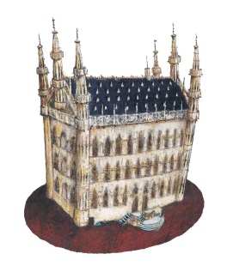
10th anniversary !

Slide 3
Balanced academic – industry organization
2010 UCB Braine l’Alleud Belgium
2011 Arlenda Louvain-la-Neuve Belgium
2012 Grünenthal Aachen Germany
2013 U. Erasmus Rotterdam The Netherlands
2014 UCLondon London UK
2015 Novartis Basle Switzerland
2016 KULeuven Leuven Belgium
2017 U. Castilla Albacete Spain
U. Cambridge Cambridge UK
2019 bioMérieux - Sanofi - SHAM France

Slide 4
Objectives Applied Bayesian Biostatistics conference
Promote use of Applied Bayesian BioStatistics in Life Science, pharmaceutical R&D and public health policies
Exchange between
Industry
Regulatory
Academic
Train with courses on specific applications
Share
Strategies to revisit common situation and handle new opportunities
The codes and solutions implemented
The impact, added values and challenges
Communicate to non-statisticians and regulatory bodies

Slide 5
Scientific Committee Applied Bayesian Biostatistics Conference
Academic
Industry
Gianluca Baio, U.C.London
Daniela Deangelis, U. Cambridge
Leonhard Held, U. Zurich
Emmanuel Lesaffre, KULeuven
Gary Rosner, John Hopkins U.
Nicky Best, GSK
Bruno Boulanger, PharmaLex
Fang Chen, SAS
Telba Irony, FDA
Heinze Schmidli, Novartis

Slide 6
The sponsors

Slide 7
Thanks to the Bayes2019 Organizing Committee
Didier Poirault bioMérieux
Elisabeth Dupont PharmaLex
Laurent Estève Sham
Karine Imberdis Sanofi
Laure Marillet bioMérieux
Alice Raillard Sanofi

