Slide 1
Latent Variable and Structural Equation Models: Bayesian Perspectives and Implementation.
Peter Congdon, Queen Mary University of London, School of Geography & Life Sciences Institute

Slide 2
Outline
Background
Bayesian approaches: advantages/cautions
Bayesian Computing, Illustrative BUGS model, Normal Linear SEM
Widening Applications
Spatial Common Factors (example of correlated units)
Nonlinear Factor Models
Case Studies

Slide 3
Background
LV and SEM models originate in psychological and educational applications, but widening range of applications, including clinical research
Latent variables (also called constructs, common factors etc.) based on sets of different indicators (or instruments, items, raters, etc), as against replicate readings on the same indicator
Multiple indicators are observed measures of underlying latent variable or variables: hence “measurement model”

Slide 4
Background
Structural equation models include both a measurement sub-model and a structural regression sub-model expressing interdependence between LVs.
Can distinguish between endogenous (response LVs) and exogenous factors (LVs with predictor role).
Example: Structural Equation Model for Pharmacist Competencies (exogenous LV) in Improving Quality of Life (endogenous LV) of Cancer Patients
Ref: Takehira et al, Pharmacology & Pharmacy, 2011, 2, pp 226-232

Slide 5
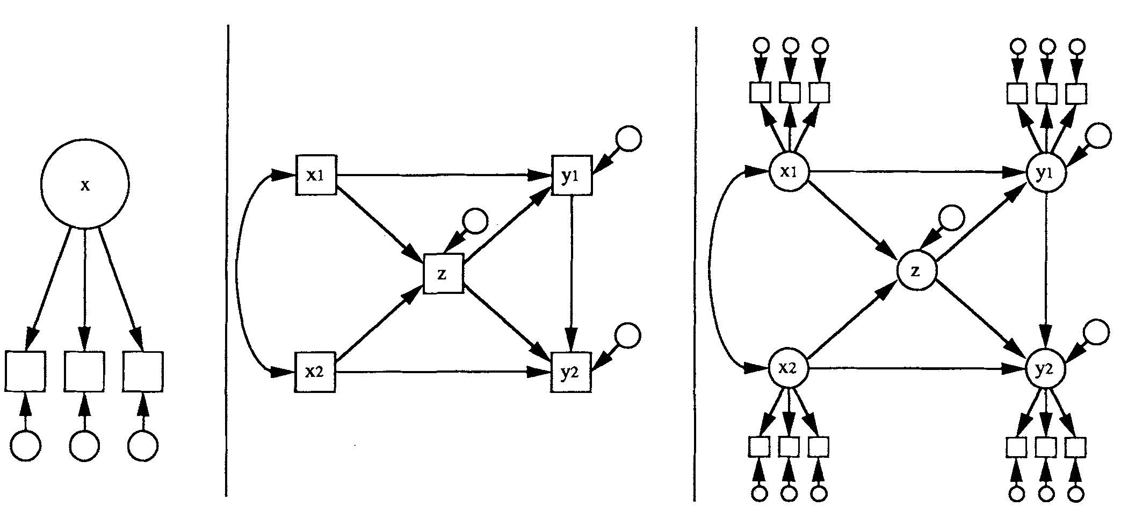
From Hoyle & Smith, 1994

Slide 6
Background
Classical methods for metric data centred on normality and independence assumptions
Analysis & estimation can then be based to inputting covariance or correlation matrices between indicators. Original observations not considered.
Bayesian methods generally specify likelihood for observations as part of hierarchical model. Recent Bayesian applications extend to disease mapping, financial econometrics, genomics.

Slide 7
Background: Normal Linear Factor Model
Many applications involve simply a measurement model, without distinguishing endogenous and exogenous factors. For M metric indicators and factors ψ of dimension p, have normal linear factor model (subjects i)
y_{i} = κ + Λψ_{i} + ε_{i},
where κ is M×1, loading matrix Λ is M×p, and errors ε_{i} are normal.
Number of identifiable parameters in Λ and cov(ψ), is less than M(M+1)/2-M, namely total available parameters under conditional independence assumption whereby
Cov(ε)=diag(σ²,σ²,…,σ²).

Slide 8
Advantages of/Cautions regarding Bayesian Approach

Slide 9
Advantages of Bayesian Approach 1
Straightforward to depart from standard assumptions such as multivariate normal likelihood and independent subjects. Can consider skewed or otherwise non-normal errors, outliers, etc.
Can allow for missing data on indicators (common in clinical applications) – and avoiding techniques such as pairwise or listwise deletion
Can have factor scores correlated over units, e.g. over areas (spatial factors) or through time (dynamic factors in financial time series)
Can obtain full densities/ extended inferences for factor scores, exceedance probabilities, comparisons between subjects etc

Slide 10
Advantages of Bayesian Approach 2
Potential for Bayesian variable selection procedures
Select only significant loadings in exploratory factor analysis
Includes sparse factor analysis procedures (in genomics).
Select only significant regression effects in structural sub-models where causal links are not necessarily established.

Slide 11
Advantages of Bayesian Approach 3
Random effect models (of which LV/SEM models are subclass) can be fitted without using numerical methods to integrate out random effects.
Wide range of inferences possible using MCMC sampling
Other options: potentially can obviate identification constraints by using hierarchical priors (conventionally define number of identified loadings and factor covariances as compared to M(M+1)/2-M).

Slide 12
Cautions in applying Bayesian Approach 1
Identification issues (re “naming” of factors): can have label switching for latent constructs during MCMC updating if there aren’t constraints to ensure consistent labelling.
Slow convergence of parameters or fit measures (e.g. DIC and effective parameter estimate) in large latent variable applications (e.g. 1000 or 10000 subjects).
Can possibly be avoided using Integrated Nested Laplace methods (INLA Package in R), though application of INLA to factor/SEM models awaits development

Slide 13
Cautions in Bayesian Approach 2
Formal Bayes model assessment (marginal likelihoods/Bayes factors) difficult for large realistic applications
Sensitivity to priors on hyperparameters (e.g. priors for factor covariance matrix)
Bayesian approach may need sensible priors when applied to factor models, even data based priors (“diffuseness” not necessarily suitable)

Slide 14
Bayesian Computing

Slide 15
Bayesian Computing
Many Bayesian applications to SEM and factor analysis facilitated by BUGS package (encompassing WINBUGS, OPENBUGS and JAGS).
See Congdon (Applied Bayesian Modelling 2nd edition,2014); Lee (Structural Equation Modeling: a Bayesian Approach, 2007)

Slide 16
Bayesian Computing
Alternatives to BUGS are:
BUGS interfaces in R (rjags, etc)
MPLUS has Bayesian options
Dedicated R libraries with Bayes inference (bfa, zelig, mlirt)
MCMC coding from scratch
BUGS coding (or MCMC coding from scratch) may allow more extensive inferences than available in dedicated packages with specified output options

Slide 17
BUGS
Despite acronym, BUGS employs Metropolis-Hastings updating where necessary as well as Gibbs sampling
Program code is essentially a description of the priors & likelihood, but can monitor model-related quantities of interest

Slide 18
Illustration

Slide 19
Illustration: Normal Linear SEM
Wheaton et al (1977) Study: assess whether alienation was stable over a period of 4 years
Three latent variables, each measured by two indicators (survey scales).
Alienation67 measured by anomia67 (1967 anomia scale) and powles67 (1967 powerlessness scale).
Alienation71 is measured in same way, but using 1971 scales.
Third latent variable, SES (socio-economic status) measured by years of schooling and Duncan's Socioeconomic Index, both in 1967.

Slide 20
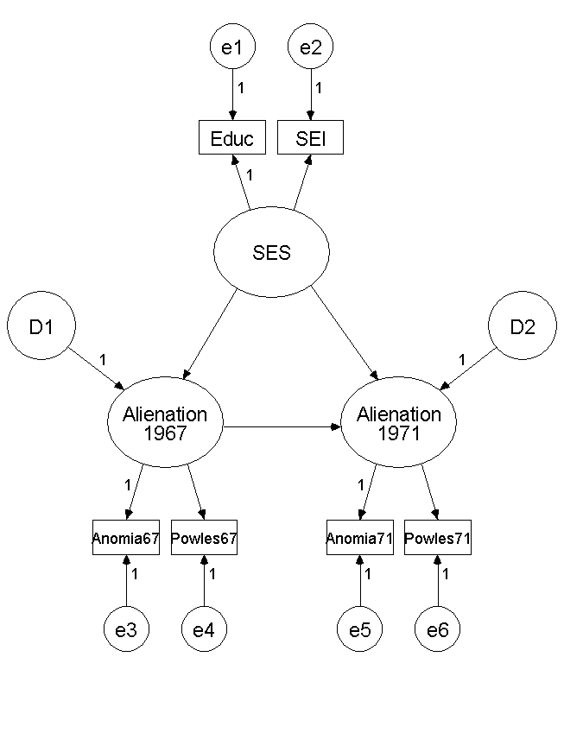

Slide 21
Structural model relates alienation in 1971 (F₂) to alienation in 1967 (F₁) and SES (G). F₁ and F₂ endogenous, G exogenous
F_{2i} = βF_{1i} + γ₂G_{i}+u_{2i}
F_{1i} = γ₁G_{i} + u_{1i}
Measurement model for alienation
y_{ji}=α_{j} +λ_{j}F_{1i} j=1,2
y_{ji}=α_{j} +λ_{j}F_{2i} j=3,4
Measurement model for SES
x_{ji}=δ_{j} +κ_{j}G_{i} j=1,2

Slide 22
BUGS code for Wheaton study (JAGS may be more economical). Standardised factors constraint
model { for (i in 1:n) { # structural model
F2[i] ~ dnorm(mu.F2[i],1);
mu.F2[i] <- beta* F1[i]+gam[2]*G[i]
F1[i] ~ dnorm(mu.F1[i],1);
mu.F1[i] <- gam[1]*G[i]}
# normal N(0,1000) priors on coefficients
# dnorm uses precision, inverse variance
for (j in 1:2) {gam[j] ~ dnorm(0,0.001)}
beta ~ dnorm(0,0.001)

Slide 23
# measurement equations for alienation
for (i in 1:n) { for (j in 1:4) { y[i,j] ~ dnorm(mu[i,j],tau[j])}
mu[i,1] <- alph[1]+lam[1]*F1[i];
mu[i,2] <- alph[2]+lam[2]*F1[i]
mu[i,3] <- alph[3]+lam[3]*F2[i];
mu[i,4] <- alph[4]+lam[4]*F2[i]}
# PRIORS
for (j in 1:4){ alph[j] ~ dnorm(0,0.001);
# gamma prior on precisions
tau[j] ~ dgamma(1,0.001)
# identifiability constraint on loadings to ensure
# alienation construct is positive measure of alienation
lam[j] ~ dnorm(1,1) I(0,)}

Slide 24
# measurement of SES (G[i])
for (i in 1:n) { G[i] ~ dnorm(0,1)
for (j in 1:2) { x[i,j] ~ dnorm(mu.x[i,j],tau.x[j])}
mu.x[i,1] <- del[1]+kappa[1]* G[i];
mu.x[i,2] <- del[2]+kappa[2]* G[i]}
for (j in 1:2) {del[j] ~ dnorm(0,0.001);
# gamma prior on precisions
tau.x[j] ~ dgamma(1,0.001)
# identifying constraint ensures +ve SES scale
kappa[j] ~ dnorm(1,1) I(0,)}}

Slide 25
Monitoring model related quantities
Use in standalone BUGS or include code in R routines calling BUGS/JAGS (e.g. rjags)
Suppose one were interested in posterior probabilities that F_{2i} > F_{1i} (alienation increasing for i^{th} subject)
Add code for subject specific binary indicators which are monitored through MCMC iterations
for (i in 1:n) {delF[i] <- step(F2[i]-F1[i])}
Posterior means of delF provide required probabilities

Slide 26
Widening Applications

Slide 27
Widening Applications of Latent Variable Methods: Space and Time Structured
Application contexts of Bayes SEM/factor models now include ecological (area level) health studies and time series. Usually no longer valid to assume units (i.e. areas, times) are independent.
In area applications, spatial correlation in latent variables (aka common spatial factors) over the areas should be considered (case study II)
Dynamic factor models now standard tools for multivariate time series econometrics and for multivariate stochastic volatility in particular

Slide 28
Widening Applications of Latent Variable Methods: Multi-Level Latent Variable Models
Latent variable methods have potential in multilevel health studies
Such models consider joint impact of individual level and area (or institution) level risk factors on health status.
Also can consider interaction between levels (e.g. test whether effect of HRQOL on patient survival varies between clinics)

Slide 29
Widening Applications of Latent Variable Methods: Multi-Level Latent Variable Models
With several outcomes and indicators (data both multivariate & multilevel) can model both latent individual risks and area effects using common factors
Latent risks may be defined by reflexive and formative indicators (case study III)

Slide 30
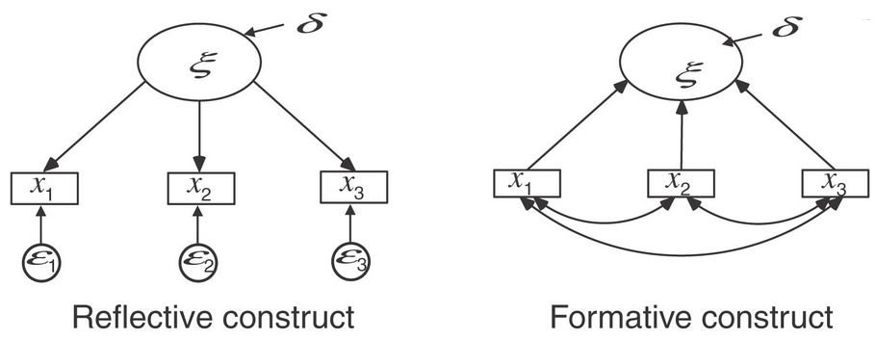

Slide 31
Spatial Priors

Slide 32
Spatial Priors for Geographic Health Datasets
Conditional Autoregressive (CAR) priors
These are priors for “structured” effects (labels of areas are important) as opposed to unstructured iid effects (exchangeable over different labellings)
Spatial factors represent unmeasured area level health risks varying relatively smoothly over space (regardless of arbitrary administrative boundaries)

Slide 34
Scenario 1: Social Indicator Confirmatory Model.
Many studies use latent area constructs to analyze population health variations, exam results, etc.
Construct scores (e.g. area deprivation scores) derived from relevant indicators using multivariate techniques or other “composite variable” methods
Many health outcomes show “deprivation gradient”
Bayesian (statistical) approach: common spatial factors (deprivation, rurality, etc) based on relevant indicators Z_{im} (m=1,..,M) such as unemployment, low income etc. Taking account of spatial structuring.

Slide 35
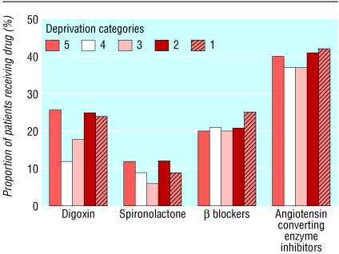
Example: McAlister et al (BMJ, 2004) compare heart failure rates, GP contact rates and prescribing data between Carstairs deprivation categories

Slide 36
Scenario 2: Area Health Outcomes as Indicators of Common Morbidity
Observed indicators y_{ij} may be deaths, hospitalizations, incidence/prevalence counts, etc
Common spatial factors as mechanism for “borrowing strength” (over indicators & areas)
Expected events (offset) E_{ij} based on standard age rates: y_{ij} ~ Poisson(E_{ij}ρ_{ij})
Univariate common spatial factor s_{i}
log(ρ_{ij})=α_{j}+λ_{j}s_{i}
Provides summary measure of health risk

Slide 37
Example: Index of Coronary Heart Disease for Small Areas, IJERPH 2010
Univariate index of CHD morbidity (p=1) for London small areas using M= 4 observed small area health indicators.
First two small area indicators (y₁, y₂) are male and female CHD deaths, while (y₃, y₄) are male and female hospitalisations for CHD

Slide 38
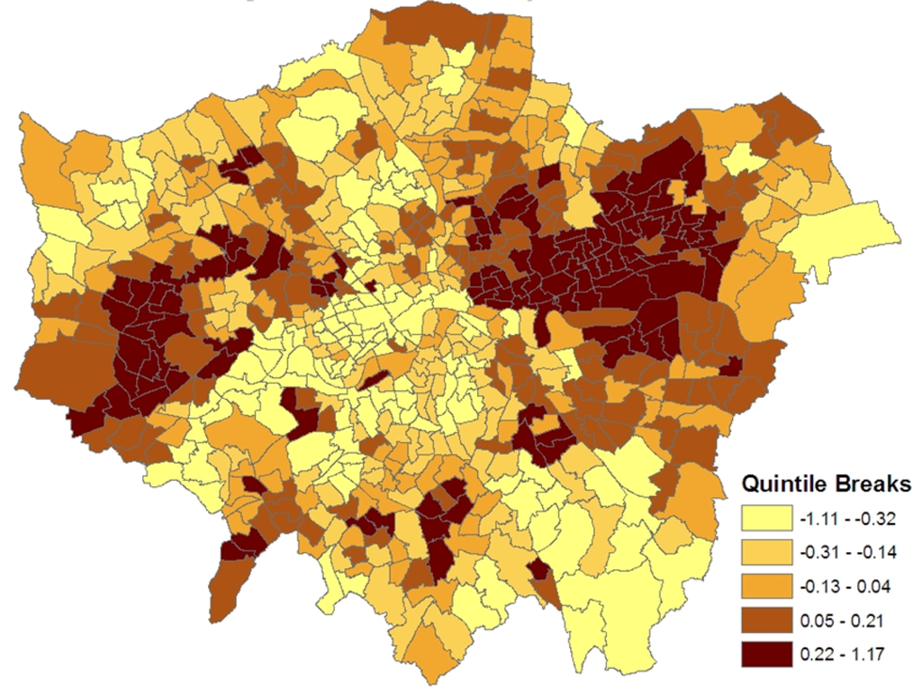

Slide 39
Identification: Location & Scale
Need Σ_{i}s_{i}=0 for location identification. Centre effects at each MCMC iteration.
Scale identifiability:
EITHER set var(s)=1, with all λ_{j} free loadings (fixed scale)
OR leave var(s) unknown and constrain a loading, e.g. λ₁=1.0 (anchoring constraint)

Slide 40
Identification: Ensuring Consistent Labelling
Consider unit variance constraint var(s)=1. Suppose diffuse priors are taken on loadings in
log(ρ_{ij})=α_{j}+λ_{j}s_{i}
without directional constraint. Then can have:
a) λ_{j} all positive combined with s_{i} as positive measure of health risk (higher s_{i} in areas with higher CHD morbidity)
OR
b) λ_{j} all negative combined with s_{i} as negative measure of health risk (s_{i} higher in areas with lower CHD morbdity)
For unambiguous labelling may be advisable to constrain one or more λ_{j} to be positive (e.g. truncated normal or gamma prior) or use anchoring constraint (e.g. λ₁ =1)

Slide 41
BUGS Code for univariate spatial factor

Slide 42
Nonlinear Latent Variables

Slide 43
Nonlinear factors
Nonlinear effects of LVs or interactions between them often relevant. Kenny and Judd (1984) specify structural model
y_{i} = κ + λ₁ψ_{1i} + λ₂ψ_{2i} + λ₃ψ_{1i} ψ_{2i} +ε_{i}
Nonlinear factor effects complicate classical estimation
Bayesian analysis involves relatively simple extensions
Example for spatial factor: simply take powers of common factor s_{i}, e.g.
log(ρ_{ij})=α_{j}+λ_{j}s_{i}+κ_{j}s²_{i}
with κ_{j} as additional unknowns.

Slide 44
Spline Models
Or spline for nonlinear effects in common factor score s_{i}. Under fixed variance var(s)=1 option, site knots ω_{k} at selected quantiles on cumulative standard normal.
Then linear spline
log(ρ_{ij})=α_{j}+λ_{j}s_{i}+Σ_{k}b_{jk}(s_{i}- ω_{k})₊
b_{jk} random effects. Difference penalties on b_{jk} replaced by stochastic analogues (random walk priors)
Ref: Lang, S., Brezger, A. (2004). Bayesian P-splines

Slide 45
CASE STUDIES

Slide 46
Case Studies
Social capital & mental health, multilevel model using Health Survey for England
Suicide and social indicators, spatial factors in ecological study for small areas (wards) in Eastern England
Cost progression in atrial fibrillation patients: Medicare patients in US. Latent morbidity defined by reflexive and formative indicators

Slide 47
Case Study I, Mental Health & Social Capital, Health Survey for England 2006
Journal of Geographic Systems 2010.
Y is mental health status (binary). Y=1 if GHQ12 score is 4 or more, Y = 0 otherwise. n=9065 adult subjects, likelihood Y_{i}~ Bern(π_{i})
π_{i} related to known subject level risk factors X and known indicators of geographic context, C (e.g. micro-area deprivation quintile, region of residence).
Additionally π_{i} related to unobserved subject level risk factors, {F_{1i},F_{2i},...,F_{pi}}
Examples: social capital, perceived stress.
Structural model: Y~f(Y|X,C,F,β,γ,λ)

Slide 48
Structural Model
Regression, log-link (→ provides relative risk interpretation).
p=1 for single latent risk factor F_{i} (social capital)
log(π_{i})=βX_{i}+γC_{i}+λF_{i} =β₀+β_{1,gend[i]}+β_{2,age[i]}+β_{3,eth[i]}+β_{4,oph[i]}+β_{5,own[i]}
+β_{6,noqual[i]}+γ_{1,reg[i]}+γ_{2,dep[i]}+γ_{3,urb[i]}+λF_{i}

Slide 49
Measurement Model: Reflexive Indicators for Social Capital
Social capital measured by M survey items (e.g. questions about neighbourhood perceptions, organisational memberships), {Z₁,...,Z_{M}}
Z~g(Z|F,κ)
e.g. with binary questions, link probability of positive response ρ_{im}=Pr(Z_{im}=1) to latent construct via
logit(ρ_{im})=δ_{m}+κ_{m}F_{i}

Slide 50
Formative Influences on Social Capital
Social capital may vary by demographic groups and geographic context (urban status, region, small area deprivation category, etc).
So have multiple potential causes of F as well as multiple reflexive indicators
F ~ h(F|X*,G*, φ)
X* and G* are individual and contextual variables relevant to causing social capital variations

Slide 51
Measurement Model
Standardised factor constraint, so that λ and κ coefficients unknown:
Z_{im}~g(Z_{im}|F_{i},κ)
F_{i}~N(μ_{i},1) μ_{i}=φ_{1,gend[i]}+φ_{2,eth[i]}+φ_{3,noqual[i]}+φ_{4,urb[i]}+φ_{5,reg[i]}
+φ_{6,depquint[i]}.
φ: fixed effects parameters with reference category (zero coefficient) for identification

Slide 52
Observed Reflexive Indicators of Social Capital
Social Support Score (Z₁)
5 binary items (Z₂-Z₆) relate to neighbourhood perceptions (e.g. can people be trusted?; do people try to be helpful?; this area is a place I enjoy living in; etc)
Final item (Z₇) relates to membership of organisations or groups.

Slide 53
Effect of F on π
Social capital has significant effect in reducing the chances of psychiatric caseness.
λ = -0.525 is coefficient for social capital effect
Relative risk 0.35 of psychiatric morbidity for high capital individuals (with score F=+1) as compared to low capital individuals (with F=-1).
Obtained as exp(-0.525)/exp(0.525), or can monitor exp(-λ)/exp(λ).

Slide 54
Micro-area Deprivation Gradient in LV, Social Capital (lower capital in more deprived areas)

Slide 55
Case Study II Suicide & Self Harm: Small Areas in Eastern England
Two classes of manifest variables
Y₁-Y₄: suicide totals in small areas (Y₁=M suic, Y₂= F suic, Y₃= M self-harm, Y₄= F self-harm)
Z₁-Z₁₄: Fourteen small area social indicators
p=3 latent constructs (F₁ social fragmentation, F₂ deprivation, F₃ urbanicity). Converse of F₃ is “rurality”. These are “common spatial factors” with prior including potential correlation between areas

Slide 56
Local Authority Map: Eastern England

Slide 57
Geographic Framework
N=1118 small areas (wards).
Small area focus beneficial: people with similar socio-demographic characteristics tend to cluster in relatively small areas, so greater homogeneity in risk factors
On other hand, health events may be rare, so benefits from borrowing strength

Slide 58
Confirmatory Measurement Sub-Model
Confirmatory Z-on-F model: each indicator Z_{k} loads only on one construct F_{q}.
For indicator k∈1,..,14, G_{k} ∈ 1,2,3 denotes
which construct it loads on.
Regression with link g allows for overdispersion via “unique” w effects
g(μ_{ik})= δ_{k}+κ[k,G_{k}]F[G_{k},i]+w_{ik}

Slide 59
Expected Direction of Confirmatory Model Loadings

Slide 60
Health Outcome (Structural) Model (Y-on-F effects)
Model for Y-on-F effects
Y_{ij} ~ Po(E_{ij}ρ_{ij}) j=1,..,4
log(ρ_{ij})=α_{j}+β_{j1}F_{1i}+β_{j2}F_{2i}+β_{j3}F_{3i}+u_{ji}
u_{ji}, iid effects for residual over-dispersion
Coefficient selection on β_{jq} using relatively informative priors under “retain” option when selection indicators J_{jq}=1 (j=1,..,4; q=1,..,3). Using diffuse priors means null model tends to be selected

Slide 64
Application III Modelling Changes in Health Spend
Aims: predict risk of deteriorating health status among atrial fibrillation patients using data on Medicare Beneficiaries in US.
Patients grouped into four consumption classes: crisis consumers, heavy consumers, moderate consumers, and light/low consumers.
Focus: transition from low or light use (at end 2007) to moderate, heavy or crisis use (by end 2008). Shifts to increased healthcare costs usually due to hospitalisation.

Slide 65
Application III Modelling Changes in Health Spend
Regression includes latent morbidity index, contextual factors (e.g. metropolitan residence), treatment (Warfarin) adherence and baseline consumption level.
Regression is bivariate: as well as considering transition (or not) to higher cost levels, mortality as subsequent or alternative outcome within annual follow-up period is also considered

Slide 66
Application III Modelling Changes in Health Spend
Response 1, y₁: Ordinal with J=4 categories, namely consumption class at end 2008. y₁=1 for patients remaining in low or light use class at end 2008; y₁=2, 3, 4 for patients moving to moderate/heavy/crisis classes
Observed y_{1i} realisations of underlying continuous scale z,
z_{i}=R_{i}+ε_{i} R_{i} represents total risk, ε_{i} denotes error term (e.g. logistic).
With cutpoints θ_{j} on z scale, have cumulative probabilities
S_{ij}=Pr(y_{1i}≤j)=F(θ_{j}-R_{i}), j=1,..,J-1
and assuming logistic errors ε_{i}, one has
logit(S_{ij})=θ_{j}-R_{i}.

Slide 67
Application III Modelling Changes in Health Spend
Influences on risk R_{i}: individual morbidity M_{i}, contextual factors C_{i} (e.g. region, local poverty), treatment variables T_{i}. There may be additional direct measures of functional status V_{i}.
Morbidity M_{i} is latent variable measured by
(a) reflexive indicators, denoted {D_{1i},...,D_{Ki}} (e.g. pre-existing medical conditions)
(b) causative indicators or risk factors, denoted X_{i}=(X_{1i},..,X_{Li}) such as age and ethnicity
Total risk:
R_{i}=α₁M_{i}+δ₁C_{i}+ψ₁V_{i} +γT_{i}.

Slide 68
Application III Modelling Changes in Health Spend
Response 2: mortality between end 2007 and end 2008 (y_{2i}=1 for death, y_{2i}=0 otherwise). Mortality provides additional information: higher morbidity subjects more likely to die earlier.
Latent morbidity M_{i} shared across the two outcomes:
y_{2i} ~ Bern(φ_{i})
logit(φ_{i})=ζ+α₂M_{i}+δ₂C_{i}+ψ₂V_{i}

Slide 69
Application III Modelling Changes in Health Spend
Assumed that latent morbidity M_{i} normal with mean X_{i}β and unknown variance σ². X_{i} are formative indicators
All reflexive indicators binary, so
M_{i} ~ N(X_{i}β,σ²)
D_{ki} ~ Bern(ρ_{ki}), k=1,..,K
logit(ρ_{ki})=κ_{k}+λ_{k}M_{i},
For scale identification, loadings λ_{k} (k=2,..,K) are taken as unknown, but λ₁=1 (anchoring constraint).
For location identifiability, X variables omit intercept.

Slide 70
Application III Modelling Changes in Health Spend
Reflexive indicators of latent morbidity: myocardial infarction (D₁=1 for MI during 2007, 0 otherwise), heart failure, diabetes, IHD, stroke/TIA, inpatient during 2007, and years with AF (D₇=1 if over 2 years, 0 otherwise).
Causative risk factors: gender, ethnicity (white non-Hisp, black non-Hisp, Hispanic, Other), age.
All K=7 reflective indicators relevant to defining morbidity. Highest loadings for heart failure, IHD and inpatient spell.
β parameters show increased age, black and Hispanic ethnicity most significant for elevated morbidity (and hence also for transition to higher spend classes or for mortality).

Slide 71
Concluding Comments
Bayesian software options for latent variable and SEM applications now more widely available
Potentialities of BUGS (and R-BUGS interfaces) in dealing with problems commonly encountered with clinical data and in providing wider range of inferences
Examples: missing values, non-normal errors, complex data structures (multi-level, longitudinal)

