Slide 1
Bayesian Analysis of Spatio-Temporal Dynamic Panel Models with Fixed and Random Effects
Mohammadzadeh, M. and Karami, H.
Tarbiat Modares University, Tehran, Iran
Rasouli, H.
Trauma Research Center, Baqiyatallah University of Medical Sciences, Tehran Iran.
^{Bayes2014}
11-13 June 2014 University College London, UK

Slide 2
Outline
1- Problem
2- Panel Regression Model
3- Dynamic Panel Model
4- Spatial Dynamic Panel Model
5- Bayesian Estimation of the Models
6- Application on Real Data
7- Conclusion

Slide 3
Problem
Observations correlated depending on their locations, are called spatial data.
Spatial data obtained in successive periods is called spatio-temporal data.
If they are independent over time, is called spatial panel data.
Due to the spatial or spatio-temporal correlation of data, it is necessary to determine their correlation structure and apply it in data analysis.

Slide 4
Problem
This requires determining the spatial or spatio-temporal covariance function, which is usually unknown and must be estimated.
A key issue in panel data modeling is variability among the experimental units.
Because of the heterogeneity between spatial locations each location may have different effects on data.
These effects can be either fixed or random.

Slide 5
Problem
In this talk a panel regression model is investigated.
Then it is developed to dynamic and spatial dynamic panel regression models.
Also, we show how the spatial fixed and random effects can be considered in these models.
The spatial and temporal correlation of data can be included simultaneously in spatial dynamic panel models.

Slide 6
Problem
Then the Bayesian estimation of the models parameters are presented.
Application of the proposed models for analysis of economic factors affecting on crime data in Tehran city is shown.
Finally, the performances of the models are evaluated.

Slide 7
Background
Baltagi (2001) and Elhorst (2003) specified the spatial panel models and estimated their parameters.
Elhorst (2003) has provided a review of issues arising in the estimation of panel models commonly used in applied researches including spatial error or spatially lagged dependent variables.
Anselin et al. (2008) introduced different types of spatial panel models.

Slide 8
Debarsy and Ertur (2010) have provided a Bayesian estimation for dynamic panel models.
Debarsy et al. (2012) interpreted the dynamic space-time panel data.
Yang and Su (2012) have estimated the parameters of dynamic panel models with spatial errors.

Slide 9
Panel Regression Model (PRM)
$$y_{it}={x′}_{it}β+μ_{it}+ε_{it}, i=1,⋯,N t=1,⋯,T$$
$y_{it}$ : observation at unit i and time t,
$x_{it}$ : $k×1 vector of exploratory variables,$
$β$ : $k×1 vector of r$egression coefficients,
$μ_{it}$ : effect of i th unit at time t,
$ε_{it} : error term, ε_{it}\sim N(0,σ^{2})$.

Slide 10
Panel Regression Model (Matrix Form)
If we set
$$y_{t}=(y_{1t},…,y_{Nt})^{′} , { X}_{t}=(x_{1t}^{′},…,x_{Nt}^{′})^{′},$$
$$μ_{t}=(μ_{1t},…,μ_{Nt})^{′} , ε_{t}=(ε_{1t},…,ε_{Nt})$$
Then the matrix form of PRM is given by
$$y_{t}=X_{t}β+μ_{t}+ε_{t}, ε_{t}\sim N(0,σ^{2}I), t=1,⋯,T$$
Dynamic Panel Regression Model (DPRM)
$$y_{t}=λy_{t−1}+X_{t}β+μ_{t}+ε_{t} ε_{t}\sim N\left(0,σ^{2}I\right), t=1,⋯,T$$
where $y_{t−1}$ is the lagged variable observed at time t-1 and $λ$ is the lagged autoregressive coefficient.

Slide 11
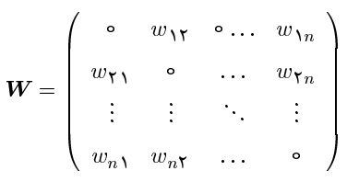
Spatial Dynamic Panel Regression Model (SDPRM)
$$y_{t}=ρWy_{t}+λy_{t−1}+X_{t}β+μ_{t}+ε_{t} ε_{t}\sim N(0,σ^{2}I)$$
where $ρ$ is spatial autoregressive coefficient and W is a spatial weight matrix:
$$w_{ij}={d_{ij}^{}}^{−α},α>0$$
$d_{ij}=$d($s_{i}−s_{j}$)=${[{\left|x_{i}−x_{j}\right|}^{p}+{\left|y_{i}−y_{j}\right|}^{p}\text{]}}^{\frac{1}{p}}$, p$≥$1

Slide 12
Bayesian Estimation of DPRM:
Prior distributions:
Conjugate priors: $σ^{2}\sim IG\left(a,b\right), β\sim N\left(β_{0},Σ_{0}\right),$
and $λ\sim U(λ_{min}^{−1},λ_{max}^{−1})$, where $λ_{min}^{}$and $λ_{max}^{}$ are minimum and maximum Eigen values of the weight matrix (San et al, 1999).
The posterior distribution is given by
$$f\left(β,λ, μ,σ^{2} | y\right)∝f\left(y | β,μ,σ^{2}\right)f\left(β\right)f(λ)f\left(μ\right)f(σ^{2})$$
But this distribution has not close form.

Slide 13
To use Gibbs sampling the full conditionals are needed:
Full conditional of $β :$
$$β|\left(y,λ, μ,σ^{2}\right)\sim N(B^{−1}b,B^{−1})$$
where
$B=(σ^{−2}\sum_{t=1}^{T}{X_{t}^{′}}X_{t}+\sum_{0}^{−1}{)}$
$b=2[ σ^{−2}\sum_{t=1}^{T}{X_{t}^{′}}(y_{t}−λy_{t−1}−μ_{t})+\sum_{0}^{−1}{β_{0}}$ ]

Slide 14
Full conditional of $σ^{2} :$
$σ^{2}|\left(y,β,λ,μ\right)\sim IG(a^{∗},b^{∗})$,
where
$a^{∗}=a+\frac{NT}{2}$,
$b^{∗}=\frac{1}{2}\sum_{t=1}^{T}{(}y_{t}−λy_{t−1}−X_{t}β−μ_{t})^{′}\left(y_{t}−λy_{t−1}−X_{t}β−μ_{t}\right)+b$

Slide 15
Full conditional of $λ$
$λ|(y,β,μ{,σ}^{2})∼N(λ_{n},γ)$
where
$λ_{n}={(\sum_{t=1}^{T}{y_{t−1}^{′}y_{t−1}})}^{−1}\sum_{t=1}^{T}{(y_{t}^{}−X_{t}β−μ_{t})′y_{t−1}}$
$γ$=${ σ}^{2}{(\sum_{t=1}^{T}{y_{t−1}^{′}y_{t−1}})}^{−1}$
Now we consider two cases for fixed and random effects.

Slide 16
a) Fixed Effects:
Suppose effects of all units are fixed at different times and
$$μ_{t}=μ= (μ_{1},…,μ_{N})^{′}\sim N(μ_{0},Γ_{0})$$
Full conditional of $μ$:
$μ|\left(y,β,σ^{2}\right)\sim N(μ_{n},Γ_{n})$
where
$μ_{n}=Γ_{n}[σ^{−2}\sum_{t=1}^{T}{(}y_{t}−λy_{t−1}−X_{t}β)+Γ_{0}^{−1}μ_{0}]$
$Γ_{n}=(Tσ^{−2}I_{N}+Γ_{0}^{−1})^{−1}$

Slide 17
b) Random Effects
Suppose random effects of all units are fixed at different times
$μ_{t}=\tilde{μ}= {\left(μ_{1},…,μ_{N}\right)}^{′}{ where μ}_{i}\sim N$($μ^{∗},$ $σ_{μ}^{2}$), i=1,$…$,N
Full conditional of $\tilde{μ}$ :
$\tilde{μ}|\left(y,β,σ^{2}\right)\sim N(μ_{n},Σ_{μ_{n}})$
where
$μ_{n}=Σ_{μ_{n}}[σ^{−2}\sum_{t=1}^{T}{(}y_{t}−λy_{t−1}−X_{t}β)+σ_{μ}^{−2}μ^{∗}I_{N}]$
$Σ_{μ_{n}}=(Tσ^{−2}I_{N}+σ_{μ}^{−2}I_{N})^{−1}$

Slide 18
Prior distributions for hyper parameters:
Suppose $μ^{∗}\sim N\left(μ_{0}^{∗},σ_{μ_{0}}^{2}\right)$and $σ_{μ}^{2}\sim IG\left(A,B\right),$
Full conditional of $μ^{∗}$:
$$μ^{∗}|(\tilde{μ}, σ_{μ}^{2})\sim N(μ_{n}^{∗}, σ_{μ_{n}^{∗}}^{2})$$
where
$$μ_{n}^{∗}=σ_{μ_{n}^{∗}}^{2}\left(σ_{μ_{0}}^{−2}μ_{0}^{∗}+σ_{μ}^{−2}ι_{N}^{′}\tilde{μ}\right)$$
$$σ_{μ_{n}^{∗}}^{2}=(σ_{μ_{0}}^{−2}+Nσ_{μ}^{−2})^{−1}$$
Full conditional of $σ_{μ}^{2}$:
$$σ_{μ}^{2}|(\tilde{μ},μ_{n}^{∗})\sim IG(A+\frac{N}{2},B+\frac{1}{2}(\tilde{μ}−μ_{n}^{∗}ι_{N})^{′}\left(\tilde{μ}−μ_{n}^{∗}ι_{N}\right))$$

Slide 19
Bayesian Estimation of SDPRM:
$$y_{t}=ρWy_{t}+λy_{t−1}+X_{t}β+μ_{t}+ε_{t} ε_{t}\sim N(0,σ^{2}I)$$
The conditional likelihood function at time t is:
$$y_{t}|(y_{t−1},β, ρ,λ,μ_{t},σ^{2})\sim N(c,Σ)$$
where
$c= ρWy_{t}$+$λy_{t−1}+X_{t}β+μ_{t}$
$Σ$=$σ^{2}{\text{(}\text{I}\text{− }ρW\text{)}}^{−1}{\text{(}\text{I}\text{− }ρW′\text{)}}^{−1}$

Slide 20
Bayesian Estimation of SDPRM:
Prior distributions:
$σ^{2}\sim IG\left(a,b\right), β\sim N\left(β_{0},Σ_{0}\right) ρ\sim U(λ_{min}^{−1},λ_{max}^{−1})$
where $λ_{min}^{}$and $λ_{max}^{}$ are minimum and maximum eigen values of the weight matrix (San et al, 1999).
The posterior distribution is given by
$$f\left(β,ρ,λ,μ,σ^{2} | y\right)∝f\left(y | β,ρ,λ,μ,σ^{2}\right)f(ρ)f\left(β\right)f\left(μ\right)f(σ^{2})$$
But this distribution has not close form.

Slide 21
To use Gibbs sampling the full conditionals are needed:
Full conditional of $β :$
$$β|\left(y,ρ,λ,μ,σ^{2}\right)\sim N(B^{−1}b,B^{−1})$$
where
$B=(σ^{−2}\sum_{t=1}^{T}{X_{t}^{′}}X_{t}+\sum_{0}^{−1}{)}$
$b=2\left(σ^{−2}\sum_{t=1}^{T}{X_{t}^{′}}\left(y_{t}−ρWy_{t}−λy_{t−1}−μ_{t}\right)+\sum_{0}^{−1}{β_{0}}\right)$

Slide 22
Full conditional of $σ^{2} :$
$σ^{2}|\left(y,β,ρ,λ,μ \right)\sim IG(a^{∗},b^{∗})$,
where
$a^{∗}=a+\frac{NT}{2}$,
$b^{∗}=\frac{1}{2}\sum_{t=1}^{T}{(}y_{t}−ρWy_{t}−X_{t}β−μ_{t})^{′}\left(y_{t}−ρWy_{t}−X_{t}β−μ_{t}\right)+b$

Slide 23
Full conditional of $ρ$
$$f\left(ρ\right|y,β,λ,μ,σ^{2})∝ |(I_{N}−ρW^{′})( I_{N}−ρW)|^{\frac{−T}{2}}exp⁡(−\frac{1}{2σ^{2}}\sum_{t=1}^{T}{ε_{t}^{′}ε_{t}})$$
where
$ε_{t}$=$y_{t}^{}−ρWy_{t}^{}−λy_{t−1}−X_{t}β−μ_{t}$
Full conditional of $λ$
$λ|(y,β,ρ,μ{,σ}^{2})∼N(λ_{n},γ)$
where
$λ_{n}=σ^{2}{(\sum_{t=1}^{T}{y_{t−1}^{′}y_{t−1}})}^{−1}\sum_{t=1}^{T}{(y_{t}^{}−ρWy_{t}^{}−X_{t}β−μ_{t})′y_{t−1}}$
$γ$=$σ^{2}{(\sum_{t=1}^{T}{y_{t−1}^{′}y_{t−1}})}^{−1}$

Slide 24
a) Fixed Effects:
Suppose effects of all units are fixed at different times and
$$μ_{t}=μ= (μ_{1},…,μ_{N})^{′}\sim N(μ_{0},Γ_{0})$$
Full conditional of $μ$:
$μ|\left(y,β,ρ,σ^{2}\right)\sim N(μ_{n},Γ_{n})$
where
$μ_{n}=Γ_{n}[σ^{−2}\sum_{t=1}^{T}{(}y_{t}−ρWy_{t}−λy_{t−1}−X_{t}β)+Γ_{0}^{−1}μ_{0}]$
$Γ_{n}=(Tσ^{−2}I_{N}+Γ_{0}^{−1})^{−1}$

Slide 25
b) Random Effects
Suppose random effects of all units are fixed at different times
$μ_{t}=\tilde{μ}= {\left(μ_{1},…,μ_{N}\right)}^{′}{ μ}_{i}\sim N$($μ^{∗},$ $σ_{μ}^{2}$), i=1,$…$,N
Full conditional of $\tilde{μ}$ :
$\tilde{μ}|\left(y,β,ρ,σ^{2}\right)\sim N(μ_{n},Σ_{μ_{n}})$
where
$μ_{n}=Σ_{μ_{n}}[σ^{−2}\sum_{t=1}^{T}{(}y_{t}−ρWy_{t}−λy_{t−1}−X_{t}β)+σ_{μ}^{−2}μ^{∗}I_{N}]$
$Σ_{μ_{n}}=(Tσ^{−2}I_{N}+σ_{μ}^{−2}I_{N})^{−1}$

Slide 26
Prior distributions for hyper parameters:
If $σ_{μ}^{2}\sim IG\left(A,B\right) and$ $μ^{∗}\sim N(μ_{0}^{∗},σ_{μ_{0}}^{2})$ then
Full conditional of $μ^{∗}$:
$$μ^{∗}|(\tilde{μ}, σ_{μ}^{2})\sim N(μ_{n}^{∗}, σ_{μ_{n}^{∗}}^{2})$$
where
$$μ_{n}^{∗}=σ_{μ_{n}^{∗}}^{2}\left(σ_{μ_{0}}^{−2}μ_{0}^{∗}+σ_{μ}^{−2}ι_{N}^{′}\tilde{μ}\right)$$
$$σ_{μ_{n}^{∗}}^{2}=(σ_{μ_{0}}^{−2}+Nσ_{μ}^{−2})^{−1}$$
Full conditional of $σ_{μ}^{2}$:
$$σ_{μ}^{2}|(\tilde{μ}, μ^{∗})\sim IG(A+\frac{N}{2},B+\frac{1}{2}(\tilde{μ}−μ_{n}^{∗}ι_{N})^{′}\left(\tilde{μ}−μ_{n}^{∗}ι_{N}\right)))$$

Slide 27
Modeling of Crime Data
Dependent variable is murder rate (per 100,000 people) in 30 cities of Iran in years 2000 -2010.
Independent variables are indexes of unemployment, industrialization and income inequality.
Accuracy of the models are compared by BIC criteria.
Prior distributions:
$β_{0}, { β}_{1}, β_{2}, β_{3}\sim N(0,{10}^{3})$
$\frac{1}{σ^{2}}\sim G\left(0.01,0.01\right) μ\sim N\left(0,100I_{N}\right)$
$μ_{i}\sim N\left(μ^{∗},σ_{u}^{2}\right) μ^{∗}\sim N\left(0,100\right)$ $σ^{2}\sim IG(0.01,0.01)$

Slide 28
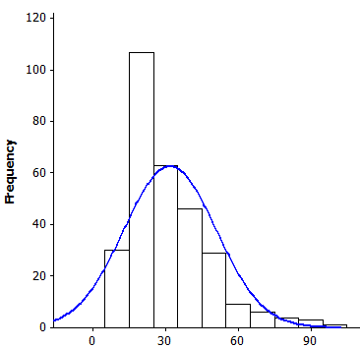
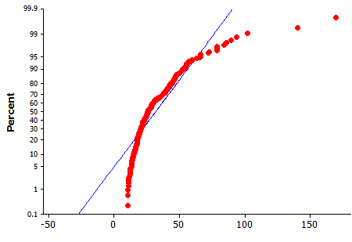
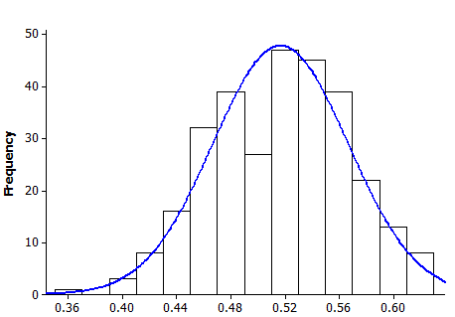
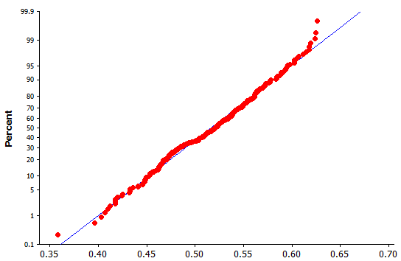
Normality of the data
Histogram
P-P plot
Data transformed by Box-Cox transformation with $λ=−0.29$ .
The p_value=0.13 for Shapiro-Wilk test shows normality of transformed

Slide 29
The Estimates of the models parameters and BIC
Items | Parameters | DPRM |  | SDPRM
 |  | Random Effect | Fixed Effect | Random Effect | Fixed Effect
Constant | $$β_{0}$$ | 13.43 | -40.65 | 73.44 | 294.78
Unemployment | $$β_{1}$$ | 0.60 | 0.49 | 0.74 | 0.58
Industrial | $$β_{2}$$ | 0.009 | 0.007 | 0.009 | 0.007
Deference income | $$β_{3}$$ | 25.82 | 24.63 | 32.96 | 31.89
Time autoregressive | $$λ$$ | 0.21 | 0.135 | -0.002 | -0.002
Variance | $$σ^{2}$$ | 538.42 | 613.57 | 538.44 | 608.38
Spatial autoregressive | $$ρ$$ | - | - | -0.138 | -0.107
BIC |  | 494 | 522 | 481 | 478
Based on BIC criteria the spatial dynamic fixed effect regression model is better than the other models

Slide 30
Conclusion
The variability between experimental units can be considered by dynamic panel regression models.
Spatial and spatio-temporal correlation of data can be considered by using spatial dynamic panel regression models.
For analysis of crime data in Tehran city, a spatial dynamic panel regression model with fixed effect is more accurate than the other models.
By using spatial dynamic panel regression model we are able to consider the spatio-temporal correlation of data without providing covariance function.

Slide 31
REFERENCES
Anselin, L., Le Gallo, J. and Jayet, H. (2008), Spatial Panel Econometrics, in The
Econometrics of Panel Data: Fundamentals and Recent Developments in Theory and Practice, Berlin, Springer. Group New York.
Mohammadzadeh, M. and Rasouli, H. R. (2013), Bayesian Analysis of Spatial Dynamic Panel Regression Models, GeoMed 2013, Sheffield, UK.
Sun, D., Robert, K., Tsutakawa, L., Paul L. S. (1999), Posterior Distribution of
Hierarchical Models Using Car(1) Distributions, Biometrika, 86, 341-350.
Yang, Z. and Su, L. (2012), QML Estimation of Dynamic Panel Data Models with Spatial Errors, 18th Reserarch International Panel Data Conference.
Baltagi, B. H. (2001), Econometric Analysis of Panel Data, Chichester, Wiley.
Debarsy, N. Ertur, C., Lesage, J., (2012), Interpreting Dynamic Space-Time Panel Data
Models, Journal of Statistical Methodology, 9, 158-171.
Elhorst, J. P. (2003), Specification and Estimation of Spatial Panel Data
Models. International Regional Science Review, 26, 244-268.

Slide 32
Thank you for your attention

