Slide 1


Contact:
Eric Rozet, Statistician
Eric.Rozet@arlenda.com
+32 (0) 473 690 914
www.arlenda.com

Slide 2
Transfer of analytical methods: the Bayesian way
E. Rozet, P. Lebrun, B. Boulanger
Eric.Rozet@arlenda.com
www.arlenda.com
June 12th 2014, Bayes 2014, London

Slide 3
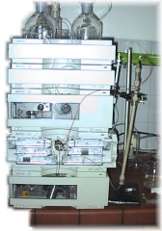
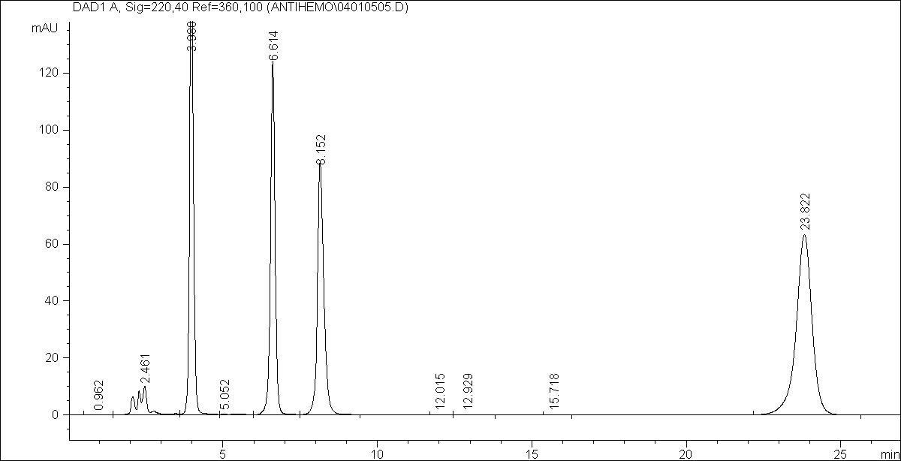
Analytical Methods
No direct quantification !
Concentration (X) = ?
signal = y
signal
Needs calibration…:
concentration
… to obtain concentration (X):
y
signal
x
concentration

Slide 4
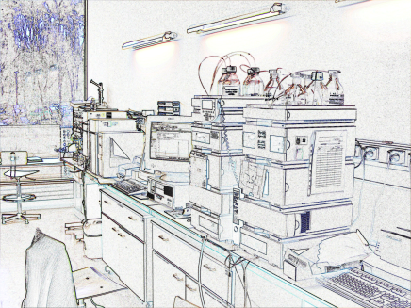
Analytical Method Life Cycle
Development
Selection
Sending lab
Validation
Life Cycle
Routine Use
Routine
use
Routine
Use
Guarantees ?
Receiving lab
Validation
Method Transfer
Reliability ?

Slide 5
Analytical Method Life Cycle
What is the final aim of quantitative analytical methods ?
  Start with the end !
  Objective: provide results used to make decisions
    Release of a batch
    Stability/Shelf life
    Patient health
    PK/PD studies, …
What matters are the results produced by the method.
Fit for purpose means: make correct decisions

Slide 6
Analytical Method Life Cycle
Need to demonstrate/guarantee that the analytical method will provide, in its future routine use, quality results in order to make correct decisions
This is the key aim of Analytical Method Transfer !
How ?

Slide 7
Analytical Method Transfer strategies
<USP 1024>: Transfer of analytical procedures
  Co-validation
  (Re)-validation
  Transfer Waiver
  Comparative testing
Comparative testing:
  Samples taken from the same produced batch are analyzed at the two laboratories
  Usually not a paired analysis due to the destructive nature of assays
  Assumes sending lab is the reference
7

Slide 8
Comparative testing: decision methodologies
4 methodologies have been proposed:
  Descriptive: point estimates only
  Difference: using bilateral Student t-test
  Equivalence: using confidence intervals of the parameters
  Total Error: using statistical tolerance intervals (β-expectation tolerance intervals)
None are fully « fit for purpose » demonstrations:
  Ensure at the end of AMT to make correct decisions (e.g. batch release)

Slide 9
Comparative testing: new proposition
The aim of AMT is to ensure that the receiving lab and sending lab will make the same decisions using the analytical results with « high » probability.

Slide 10
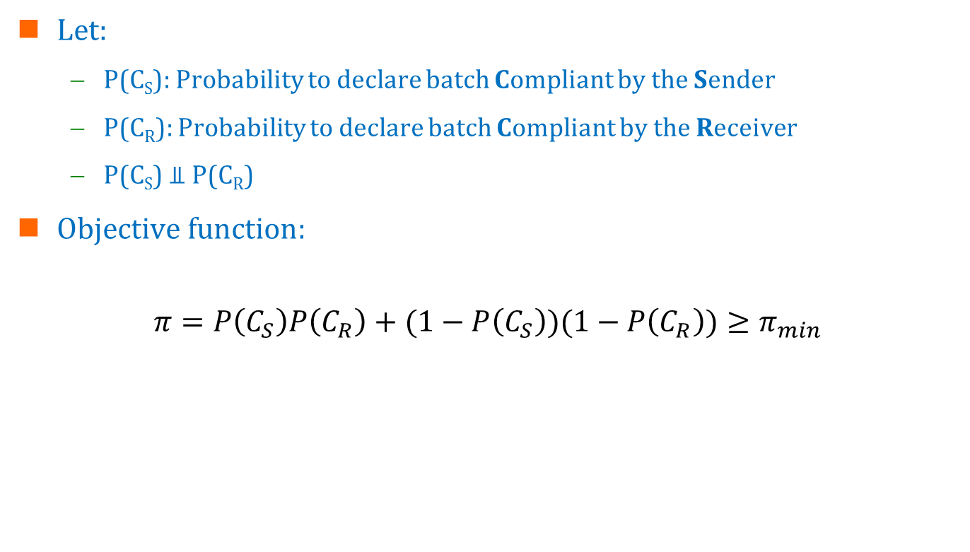
Comparative testing: new proposition
Let:
  P(C_{S}): Probability to declare batch Compliant by the Sender
  P(C_{R}): Probability to declare batch Compliant by the Receiver
  P(C_{S}) ⫫ P(C_{R})
Objective function:
$$π=P\left(C_{S}\right)P\left(C_{R}\right)+(1−P\left(C_{S}\right))(1−P\left(C_{R}\right))≥π_{min}$$
Proba to be compliant in the 2 labs
Proba to be non compliant in the 2 labs
Proba to make the same decision in the 2 labs

Slide 11
Comparative testing: common design
Batch A
Sending Lab
Run 1
Run 2
Receiving Lab
Run 1
Run 2
…
…
Rep1
Rep 2
…
Rep 1
Rep 2
…
Rep 1
Rep 2
…
Rep 1
Rep 2
…
Rep 1
Rep 2
Rep 3
Rep 1
Rep 2
…

Slide 12
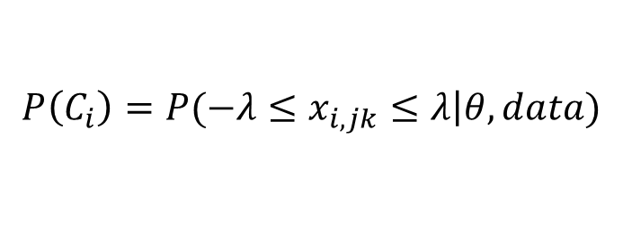

Comparative testing: common model
By laboratory i:
  One Way Random ANOVA model
  Compute the posterior probability to have results within specifications (λ)
  Then:
  $$π=P\left(C_{S}\right)P\left(C_{R}\right)+(1−P\left(C_{S}\right))(1−P\left(C_{R}\right))$$
$$P\left(C_{i}\right)=P(−λ≤x_{i,jk}≤λ\left|θ,data)\right.$$

Slide 13
Case 1: Content HPLC assay
Transfer between two QC labs of an HPLC assay to quantify an active substance in a drug product
  Data taken from:
    Dewé et al., Using total error as decision criterion in analytical method transfer, Chemom. Intel. Lab. Syst. 85 (2007) 262–268.
  Design:
    1 batch
    Sender: 1 run 6 replicates
    Receiver: 3 runs, 6 replicates per run
    Specification limits (λ): ±5% around the target content

Slide 14
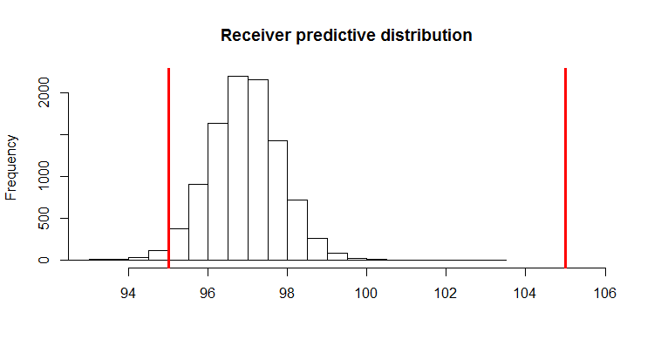
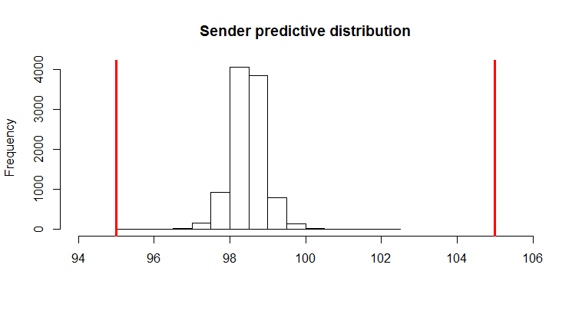
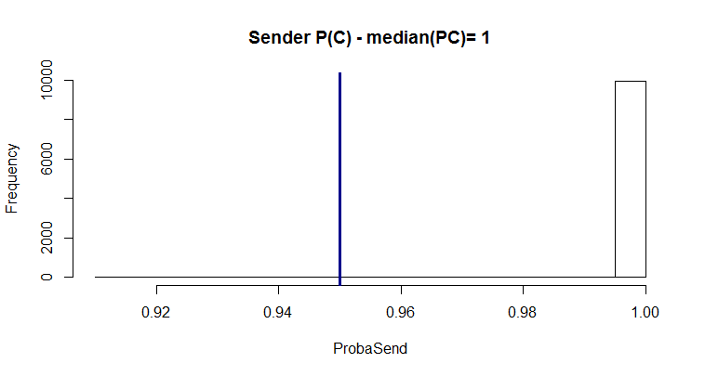
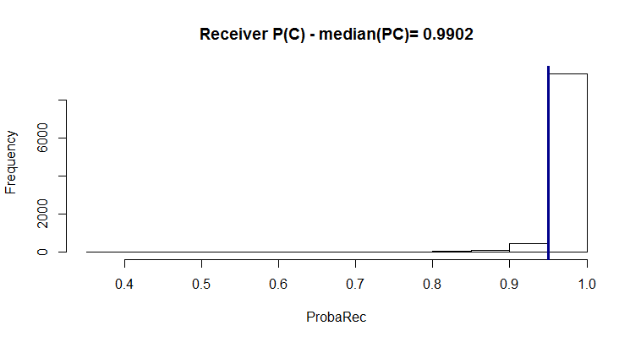
Case 1: Content HPLC assay
Sending laboratory
Receiving laboratory

Slide 15
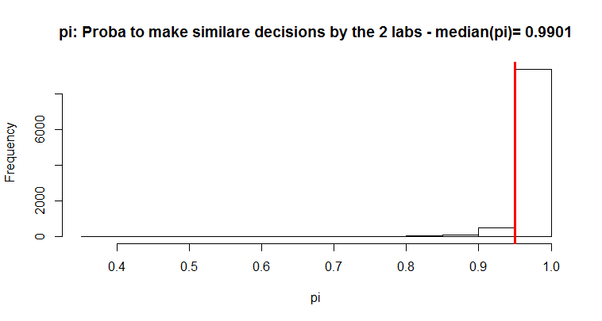

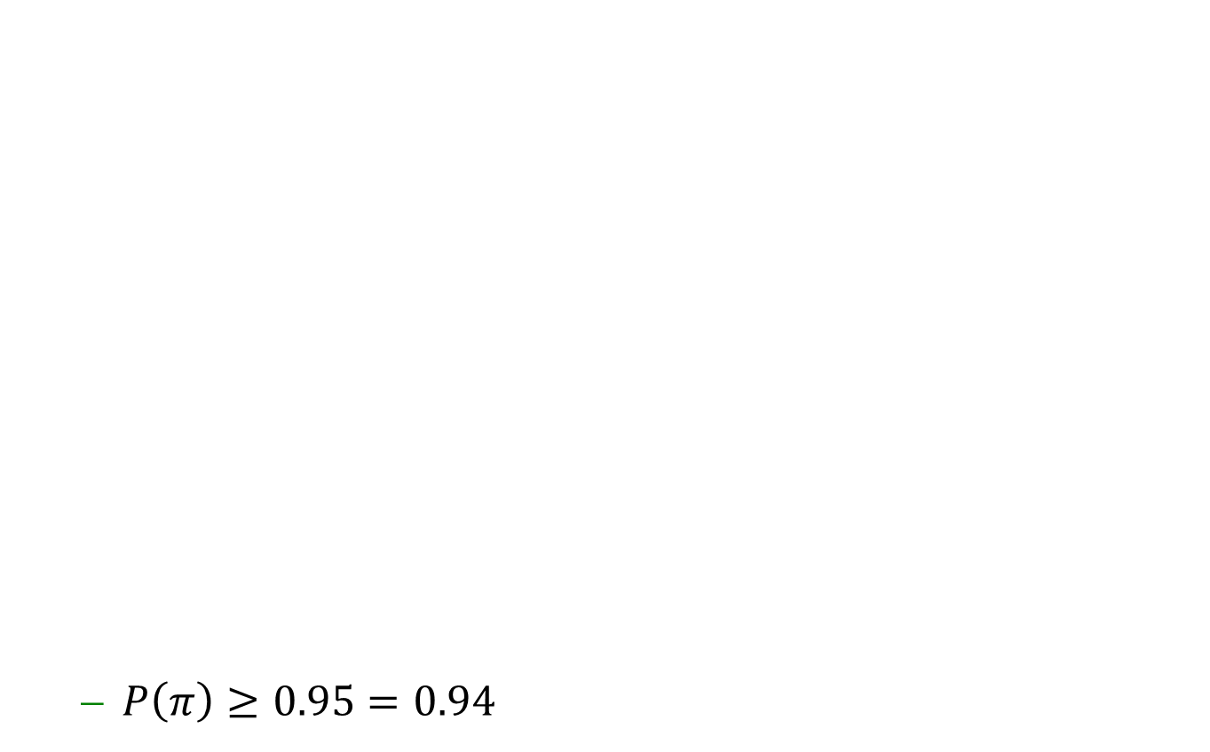
Case 1: Content HPLC assay
  $P\left(π\right)≥0.95=0.94$
$$π_{min}=0.95$$

Slide 16
Case 2: Bioassay
Transfer between two QC labs of parallel line assay
  Data taken from:
    2012 PDA (Parenteral Drug Association) Technical report N°57 Analytical Method Validation and Transfer for Biotechnology products.
  Design:
    1 batch
    Sender: 4 runs, 2 replicates per run
    Receiver: 4 runs, 2 replicates per run
    Specification limits (λ): ±10% around the target content

Slide 17
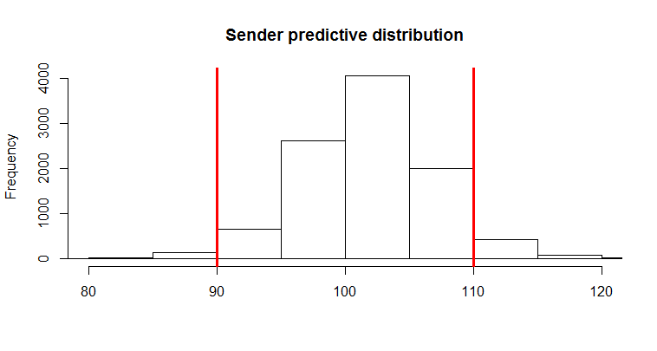
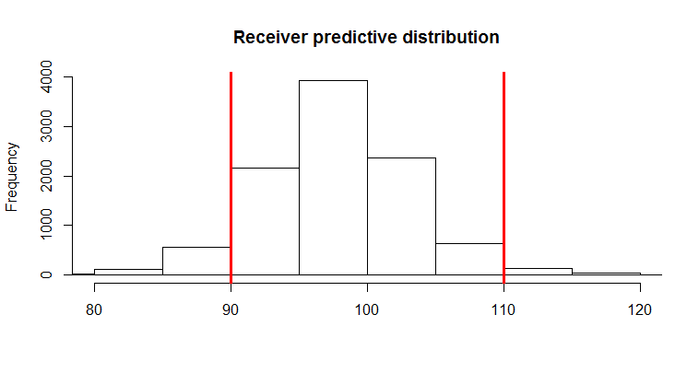
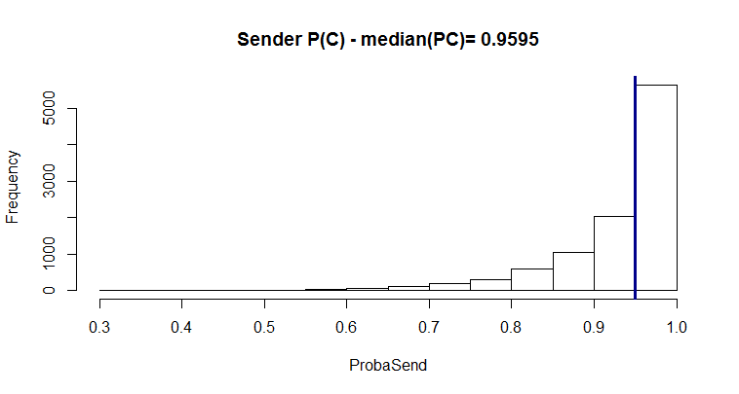
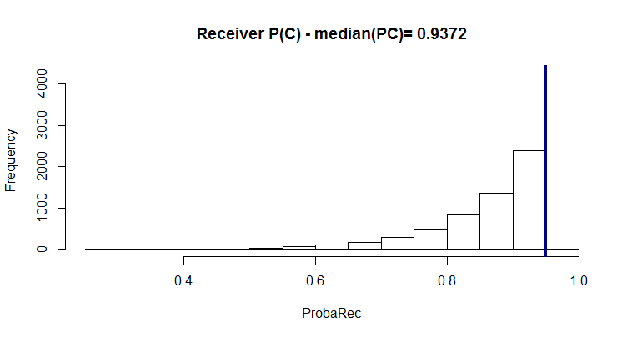
Case 2: Bioassay
Sending laboratory
Receiving laboratory

Slide 18
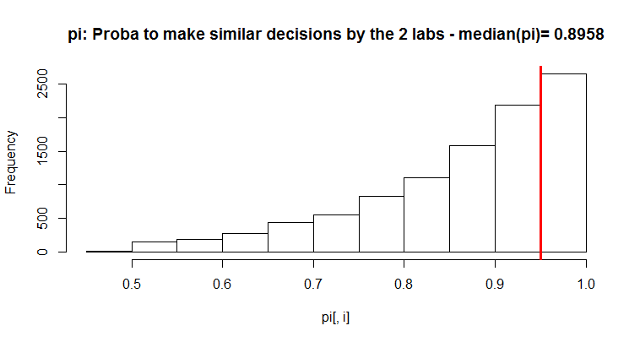
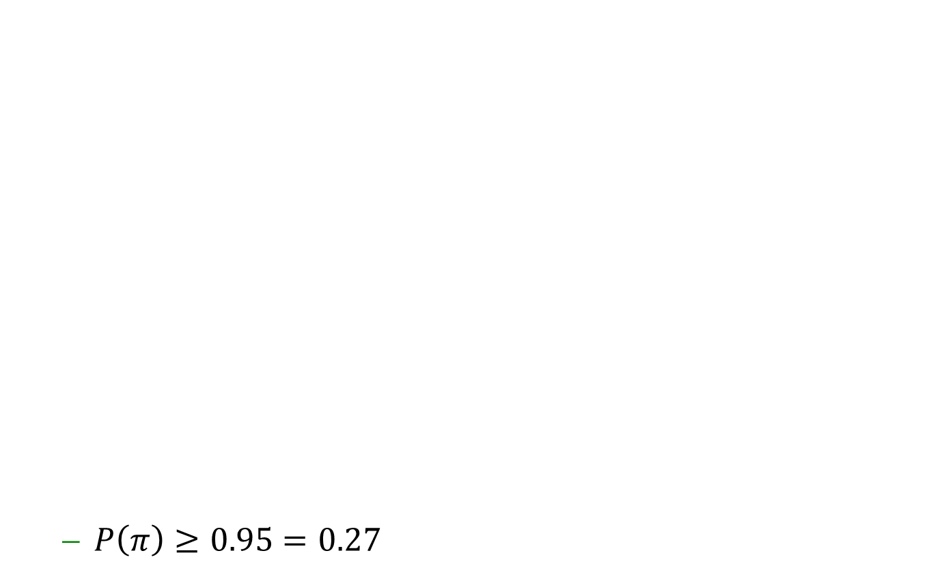
Case 2: Bioassay
  $P\left(π\right)≥0.95=0.27$
$$π_{min}=0.95$$

Slide 19
Case 3: Impurity HPLC assay
Transfer between to QC labs of an HPLC assay to quantify an impurity in a drug product
  Data taken from:
    Rozet et al, The transfer of a LC-UV method for the determination of fenofibrate and fenofibric acid in Lidoses: Use of total error as decision criterion, J. Pharm. Biomed. Anal. 42 (2006) 64–70 .
  Design:
    1 batch
    Sender: 1 run 3 replicates
    Receiver: 5 runs, 3 replicates per run
    Specification limits (λ): <0.180 mg of impurity

Slide 20
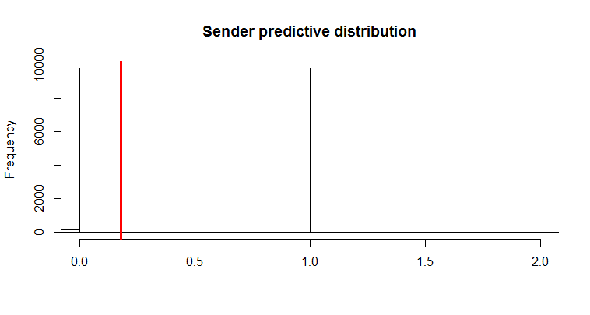
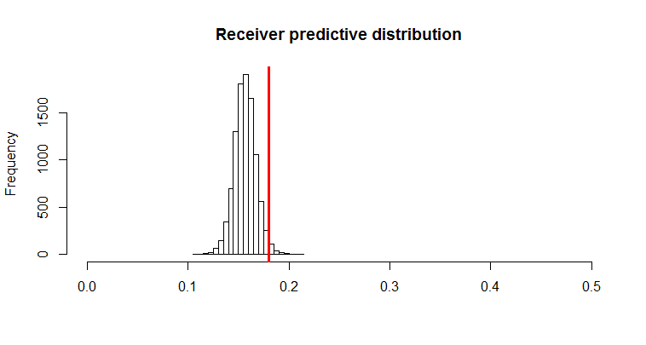
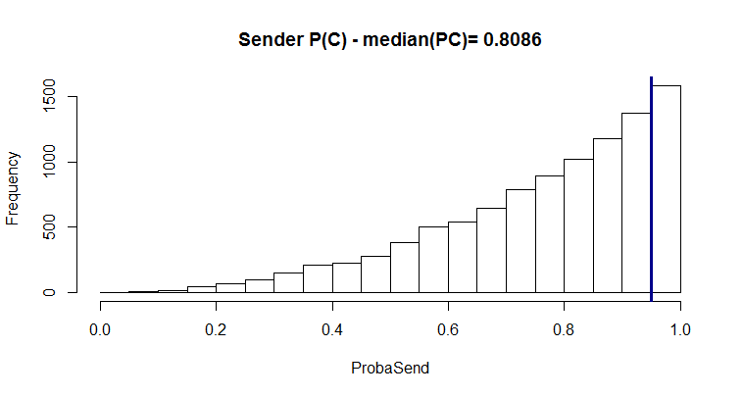
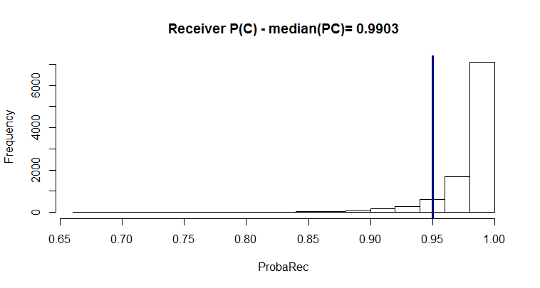
Case 3: Impurity HPLC assay
Sending laboratory
Receiving laboratory

Slide 21
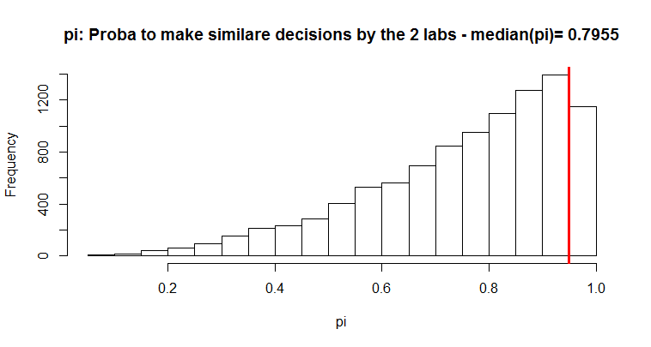


Case 3: Impurity HPLC assay
  $P\left(π\right)≥0.95=0.12$
$$π_{min}=0.95$$

Slide 22


Case 3: Impurity HPLC assay
Using informative prior for sending lab
  $P\left(π\right)≥0.95=0.91$
$$π_{min}=0.95$$

Slide 23
Conclusions
The proposed methodology allows to make a real fit for purpose decision about the acceptability of the Analytical Method Transfer
Probability of success allows to make a risk based decision
Applicable to any type of assays not only quantitative ones
Easy extension to more complex designs (several batches, …)
Allows to incorporate prior information

Slide 24
Contact:
Eric Rozet, Statistician
Eric.Rozet@arlenda.com
+32 (0) 473 690 914
www.arlenda.com

