Slide 1
Using Propensity Score to adjust for unmeasured confounders in small area studies
Yingbo Wang¹, Marta Blangiardo¹, Nicky Best ¹, Sylvia Richardson²
¹MRC-PHE Centre for Environment and Health, Imperial College London and
²MRC Biostatistics Unit, Cambridge
BAYES 2014

Slide 2
Presentation Outline
Multi-level modelling + Missing confounders?
Why Propensity Score (PS)?
The PS models – M1+M2+M3
PM10 impact on CVD hospitalisation in England

Slide 3
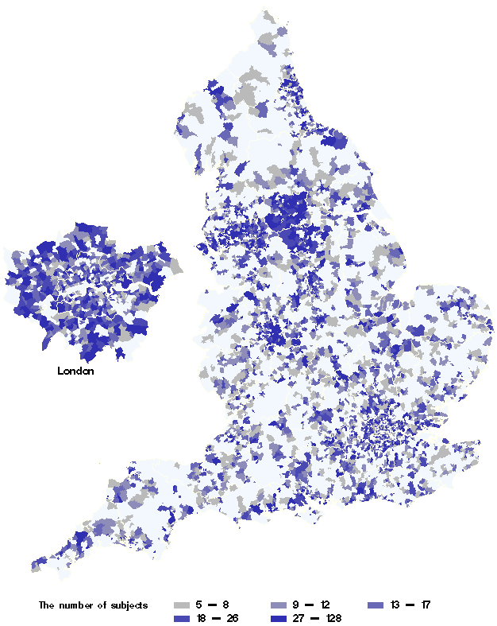
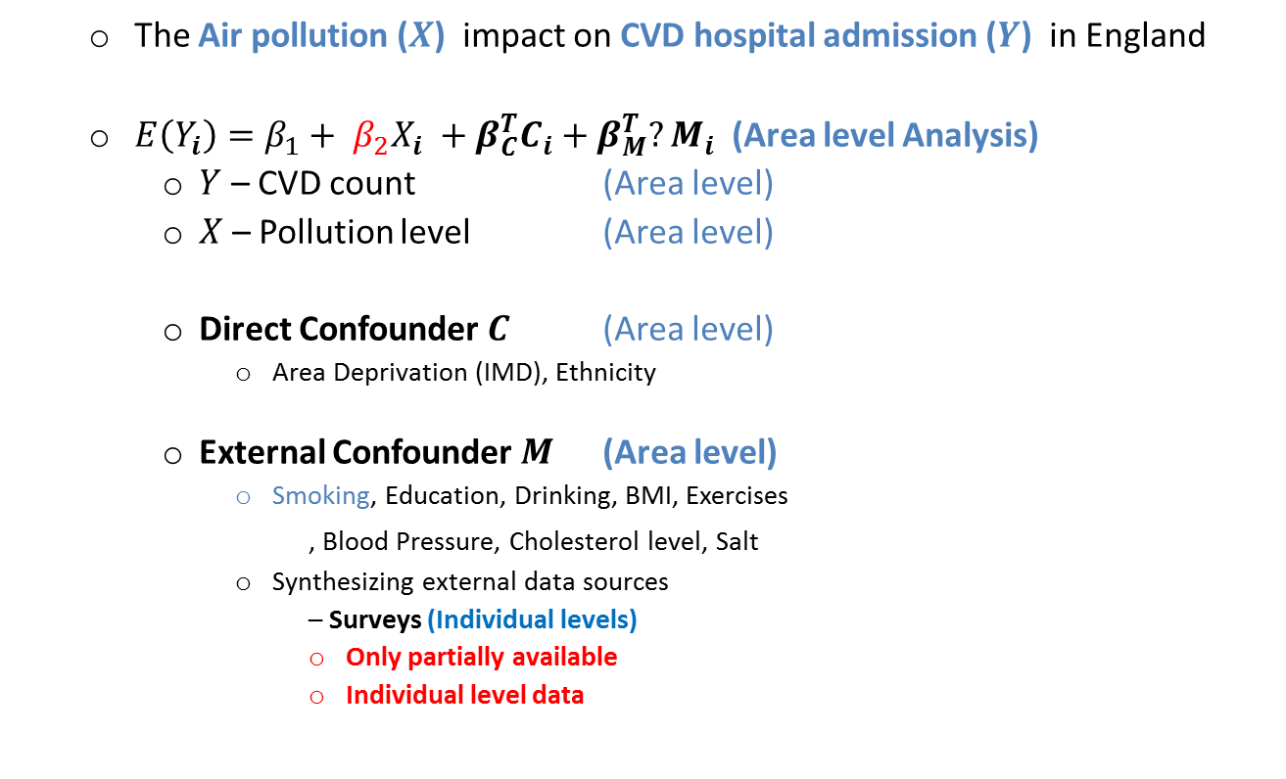
Background:
The missing confounders
  The Air pollution ($X$) impact on CVD hospital admission ($Y$) in England
  $E\left(Y_{i}\right)=β_{1}+ β_{2}X_{i} +β_{C}^{T}C_{i}+β_{M}^{T}{?M}_{i}$ (Area level Analysis)
    $Y$ – CVD count (Area level)
    $X$ – Pollution level (Area level)
    Direct Confounder $C$ (Area level)
      Area Deprivation (IMD), Ethnicity
    External Confounder $M$ (Area level)
      Smoking, Education, Drinking, BMI, Exercises
    , Blood Pressure, Cholesterol level, Salt
      Synthesizing external data sources
      – Surveys (Individual levels)
        Only partially available
        Individual level data

Slide 4

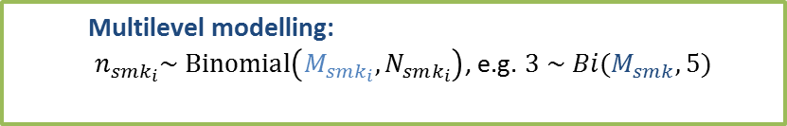


Using PS to deal with Unmeasured confounders $M$:
$$E\left(Y_{i}\right)=β_{1}+ β_{2}X_{i} +β_{C}^{T}C_{i}+β_{M}^{T}{?M}_{i}$$
England
Ward 1
Individual 1
Individual $N_{1}$
Individual 𝑁_1
Ward 8000 +
Individual 1
Area level data: Y, X, C, ?M
Individual level Survey Data: m
Individual 2
Individual $N_{i}$
Individual 𝑁_𝑖
Ward 2
?
* The average ward size in England is approximately 6,500 people
  Multilevel modelling:
  $n_{smk_{i}}\sim Binomial\left(M_{smk_{i}},N_{smk_{i}}\right)$, e.g. $3 \sim Bi(M_{smk},5)$
M1: Multilevel PS
  $$E\left(Y\right)=β_{0}+ β_{2}X+β_{C}^{T}C+g(PS)$$
M2: PS adjustment
  Missing data $M$
  $$M_{smk_{i}}=?$$
M3: Missing PS

Slide 5
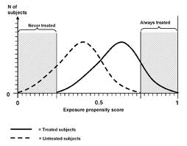
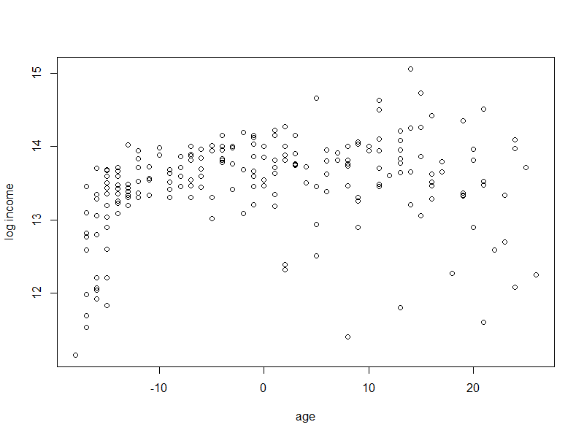
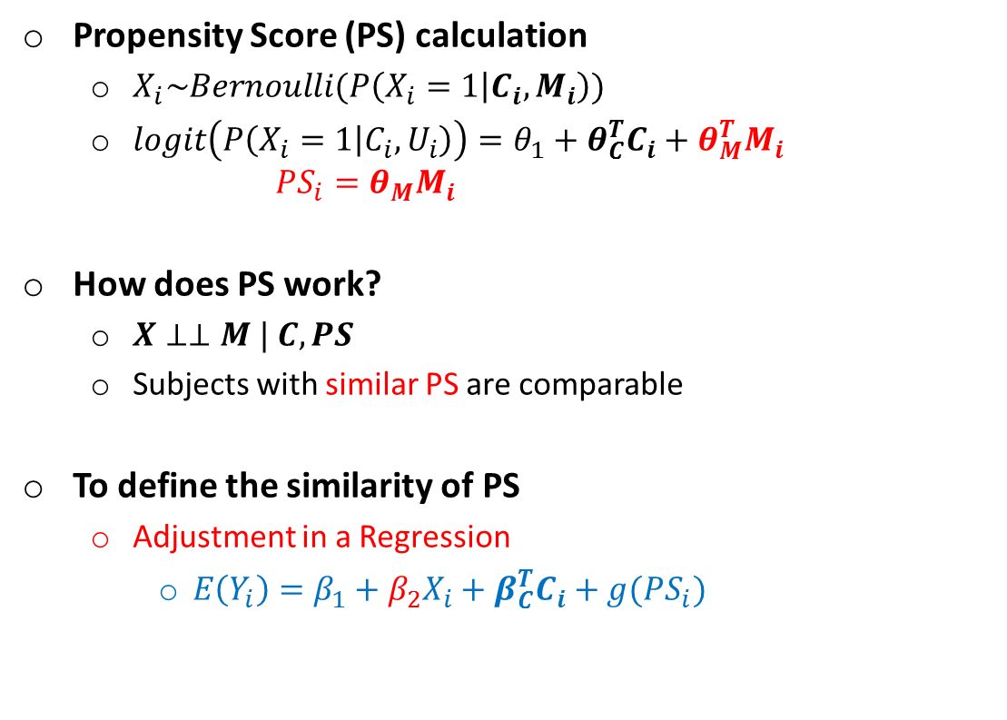

What is PS?
Propensity Score (PS) calculation
  $X_{i}\sim Bernoulli(P\left(X_{i}=1 | C_{i},M_{i}\right))$
  $logit\left(P\left(X_{i}=1 | C_{i},U_{i}\right)\right)=θ_{1}+θ_{C}^{T}C_{i}+θ_{M}^{T}M_{i}$ $PS_{i}=θ_{M}M_{i}$
How does PS work?
  $X⊥⊥M | C,PS$
  Subjects with similar PS are comparable
To define the similarity of PS
  Adjustment in a Regression
    $E\left(Y_{i}\right)=β_{1}+β_{2}X_{i}+β_{C}^{T}C_{i}+g(PS_{i})$
PS Density
Outcome $Y$
PS

Slide 6
The PS modelling framework
M1: PS calculation
M2: PS Adjust. model
M3: PS imputation

Slide 7
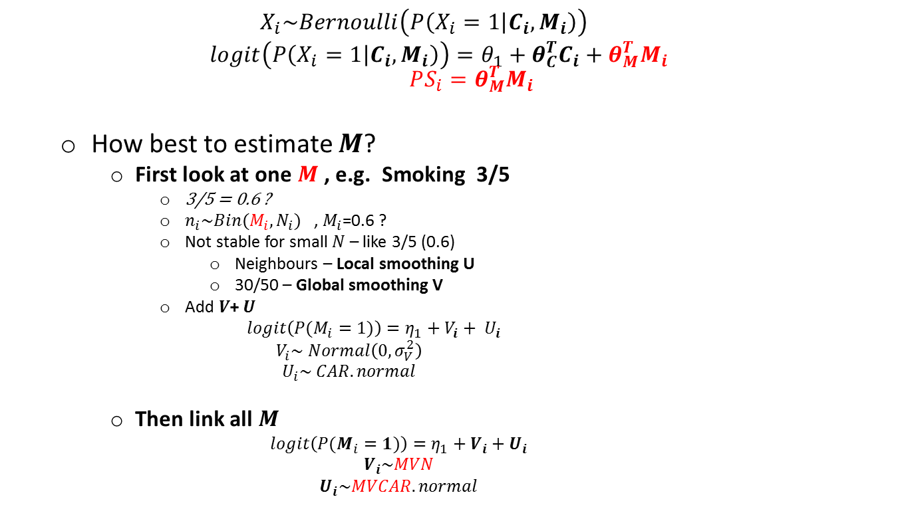

    In the areas where survey is available
    M1: Multilevel $PS$
  $$X_{i}\sim Bernoulli\left(P\left(X_{i}=1 | C_{i},M_{i}\right)\right)$$
  $logit\left(P\left(X_{i}=1 | C_{i},M_{i}\right)\right)=θ_{1}+θ_{C}^{T}C_{i}+θ_{M}^{T}M_{i}$ $PS_{i}=θ_{M}^{T}M_{i}$
  How best to estimate $M$?
    First look at one $M$ , e.g. Smoking 3/5
      3/5 = 0.6 ?
      $n_{i}\sim Bin(M_{i},N_{i})$ , $M_{i}$=0.6 ?
      Not stable for small $N$ – like 3/5 (0.6)
        Neighbours – Local smoothing U
        30/50 – Global smoothing V
      Add $V$+ $U$
      $$logit\left(P(M_{i}=1)\right)=η_{1}+{V_{i}+ U}_{i}$$
        $$V_{i}\sim Normal\left(0,σ_{V}^{2}\right)$$
        $$U_{i}\sim CAR.normal$$
    Then link all $M$
    $$logit\left(P(M_{i}=1)\right)=η_{1}+V_{i}+U_{i}$$
    $$V_{i}\sim MVN$$
    $$U_{i}\sim MVCAR.normal$$
0.6
0.1
0.1
0.1
0.1
0.1
0.1
0.4
0.2
0.2
0.2
0.2
0.2
0.2

Slide 8
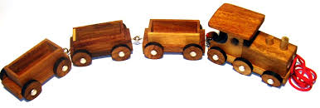

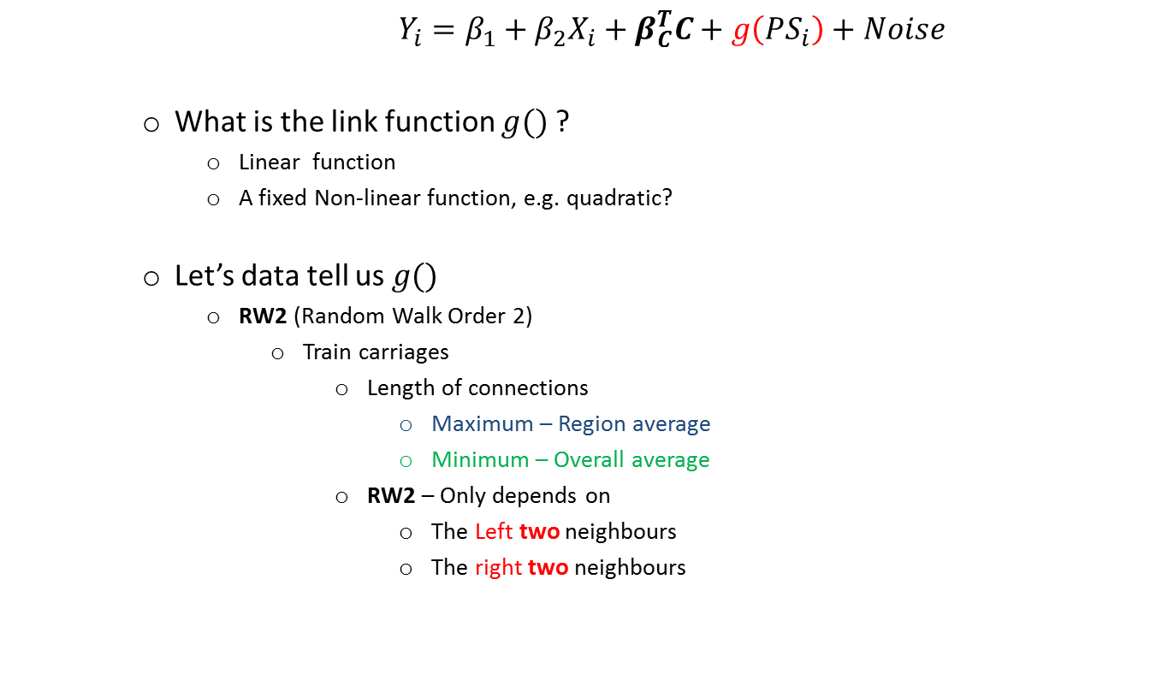
    In the areas where survey is available
    M2: PS adjustment
    $Y_{i}=β_{1}+β_{2}X_{i}+β_{C}^{T}C+g\left(PS_{i}\right)+Noise$
    What is the link function $g()$?
      Linear function
      A fixed Non-linear function, e.g. quadratic?
    Let’s data tell us $g()$
      RW2 (Random Walk Order 2)
        Train carriages
          Length of connections
            Maximum – Region average
            Minimum – Overall average
          RW2 – Only depends on
            The Left two neighbours
            The right two neighbours
Outcome $Y$
PS

Slide 9
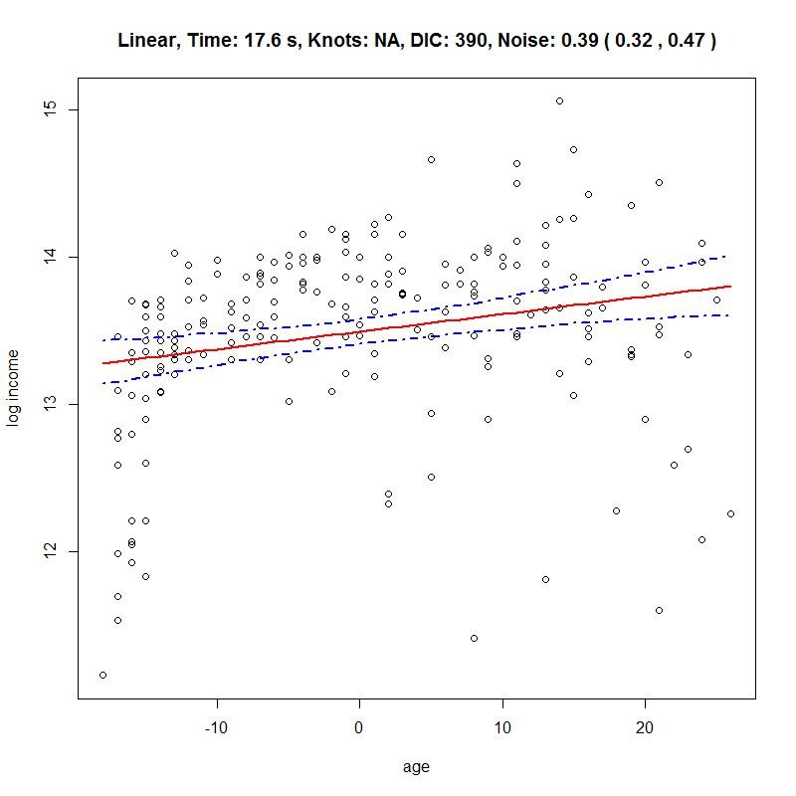
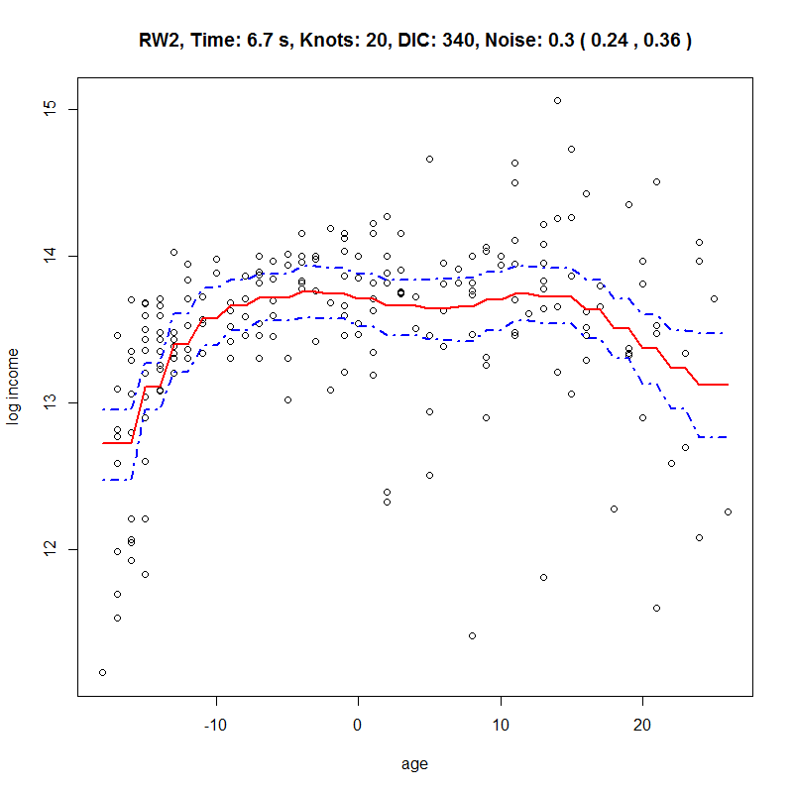


    In the areas where survey is available
    M2: PS adjustment - Example
Outcome $Y$
Outcome $Y$
PS
PS

Slide 10
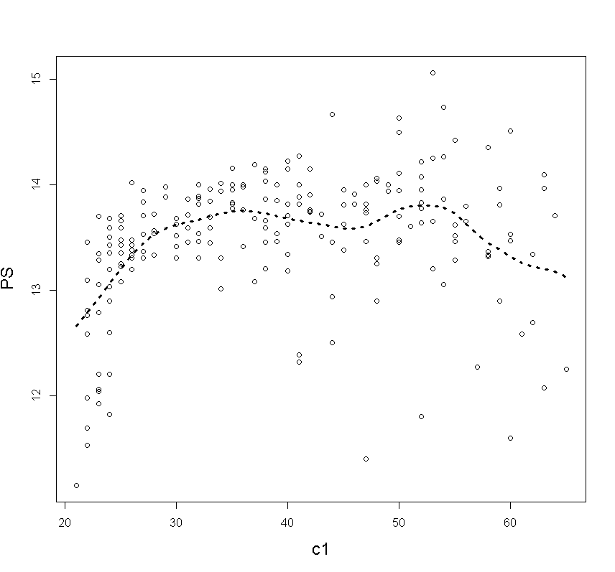

    In the areas where survey is NOT available
    M3: PS Imputation
    $${E(Y}_{i})=β_{1}+β_{2}X_{i}+β_{C}^{T}C_{i}+RW2(PS_{i})$$
When $PS_{i}$ is missing
  Posterior of $PS_{i}$ -> Likelihood of $PS_{i}$ * Prior of PS
  Likelihood of $PS_{i}$
    $∏{f(Y}_{i}|β,PS_{i},X_{i},C_{i})$
    $∏{f(X}_{i}|θ,PS_{i},C_{i})$
      $logit\left(X_{i}=1\right)=θ_{1}+θ_{C}C_{i}+PS_{i}$
  Prior of $PS_{i}$
    $E\left(PS_{i}\right)=f(C)$ with unknown $f()$
    What is $f()$?
      Linear (Current practice)?
      Non-linear + heterogeneity
        Profile regression
        - Dirichlet Process Mixture Regression
          $PS=ProfReg(C)$

Slide 11
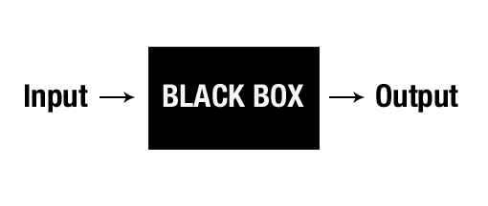
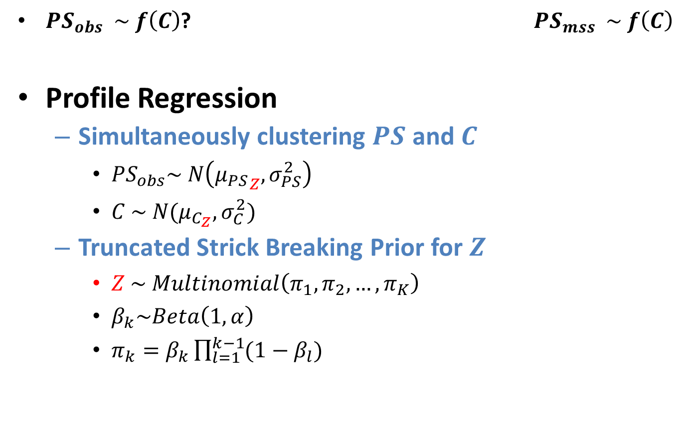
    Profile Regression – Construction
$PS_{obs} \sim f\left(C\right)$? $PS_{mss} \sim f\left(C\right)$
Profile Regression
  Simultaneously clustering $PS$ and $C$
    $PS_{obs}\sim N\left({μ_{PS}}_{Z}, σ_{PS}^{2}\right)$
    $C \sim N(μ_{C_{Z}},σ_{C}^{2})$
  Truncated Strick Breaking Prior for $Z$
    $Z \sim Multinomial\left(π_{1},π_{2},…,π_{K}\right)$
    $β_{k}\sim Beta\left(1,α\right)$
    $π_{k}=β_{k}\prod_{l=1}^{k−1}{(1−β_{l})}$

Slide 12
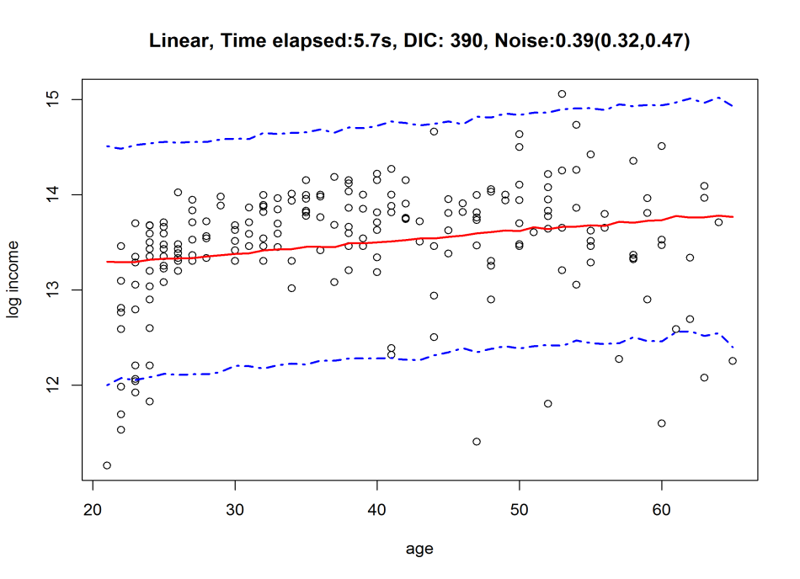
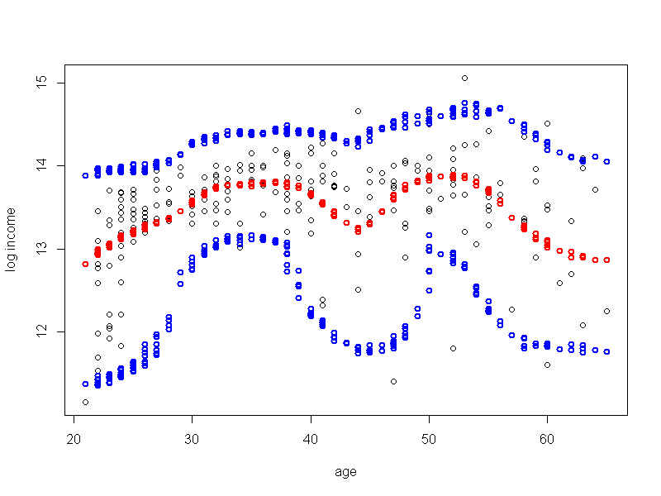
    In the areas where survey is NOT available
    M3: PS imputation- Example
Linear imputation model
PS
PS
C1
ProfReg – 25 Clusters
C1
PS
C1

Slide 13
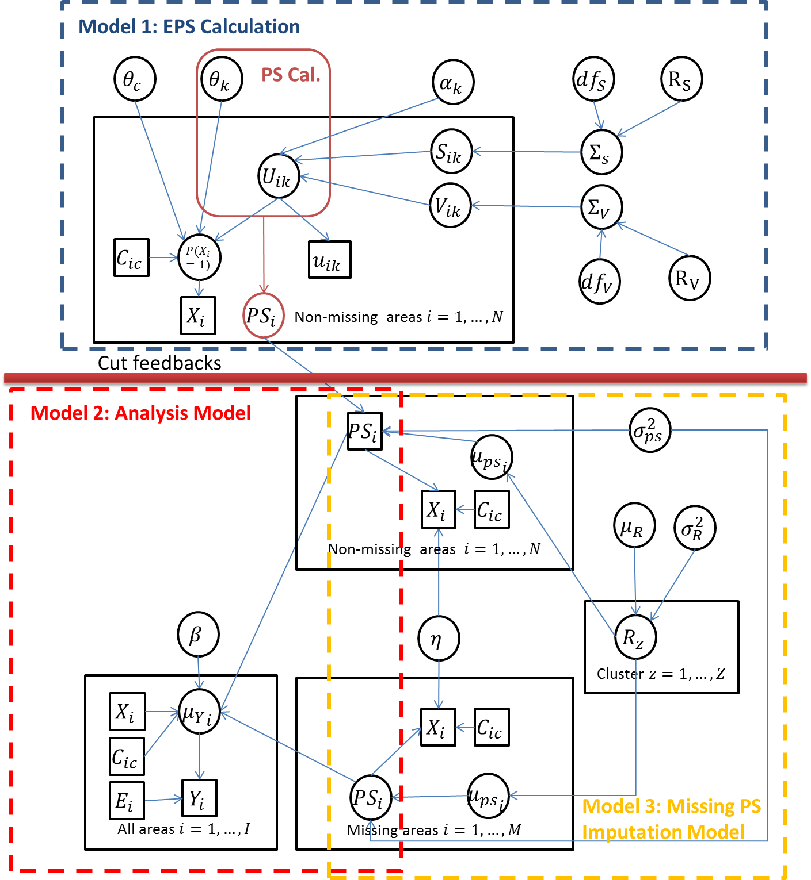
The DAG of three interlinked PS models

Slide 14
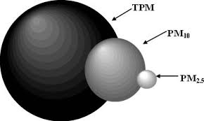
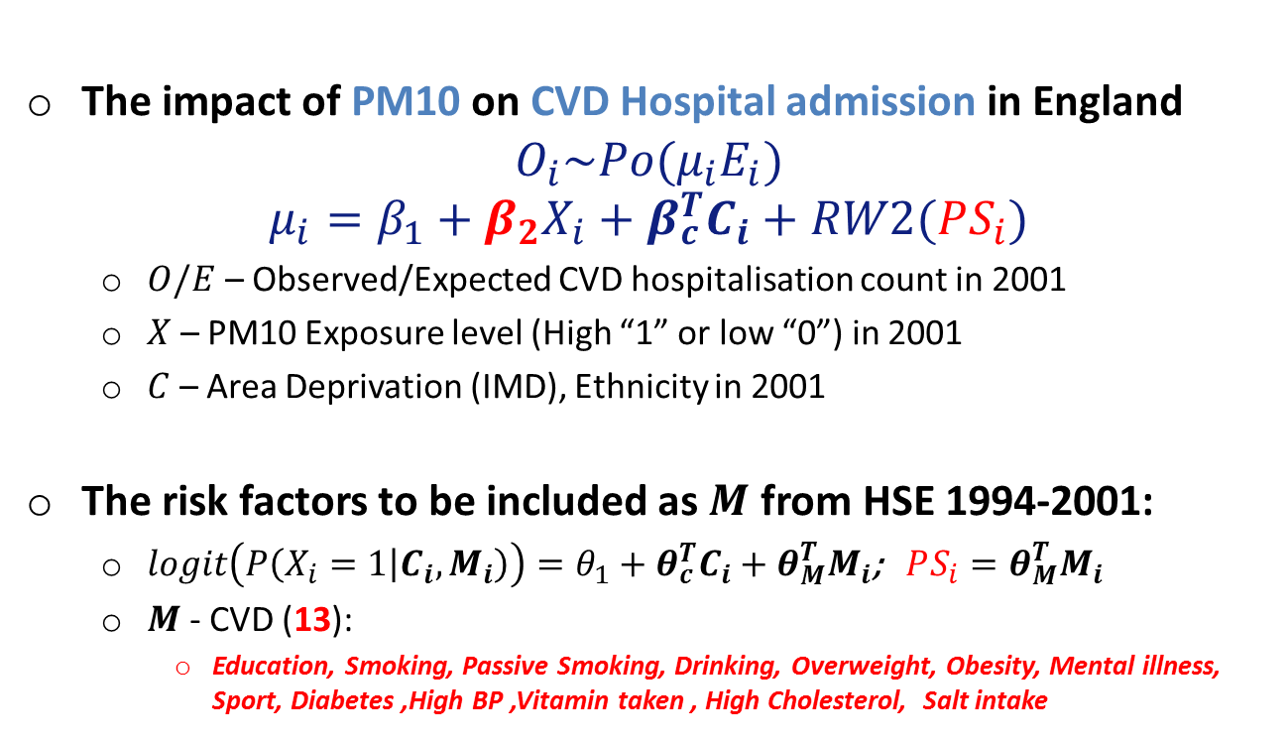
The impact of PM10 on CVD Hospitalisation
The impact of PM10 on CVD Hospital admission in England
$$O_{i}\sim Po(μ_{i}E_{i})$$
$$μ_{i}=β_{1}+β_{2}X_{i}+β_{c}^{T}C_{i}+RW2(PS_{i})$$
  $O/E$ – Observed/Expected CVD hospitalisation count in 2001
  $X$ – PM10 Exposure level (High “1” or low “0”) in 2001
  $C$ – Area Deprivation (IMD), Ethnicity in 2001
The risk factors to be included as $M$ from HSE 1994-2001:
  $logit\left(P\left(X_{i}=1 | C_{i},M_{i}\right)\right)=θ_{1}+θ_{c}^{T}C_{i}+θ_{M}^{T}M_{i}$; $PS_{i}=θ_{M}^{T}M_{i}$
  $M$ - CVD (13):
    Education, Smoking, Passive Smoking, Drinking, Overweight, Obesity, Mental illness, Sport, Diabetes ,High BP ,Vitamin taken , High Cholesterol, Salt intake

Slide 15
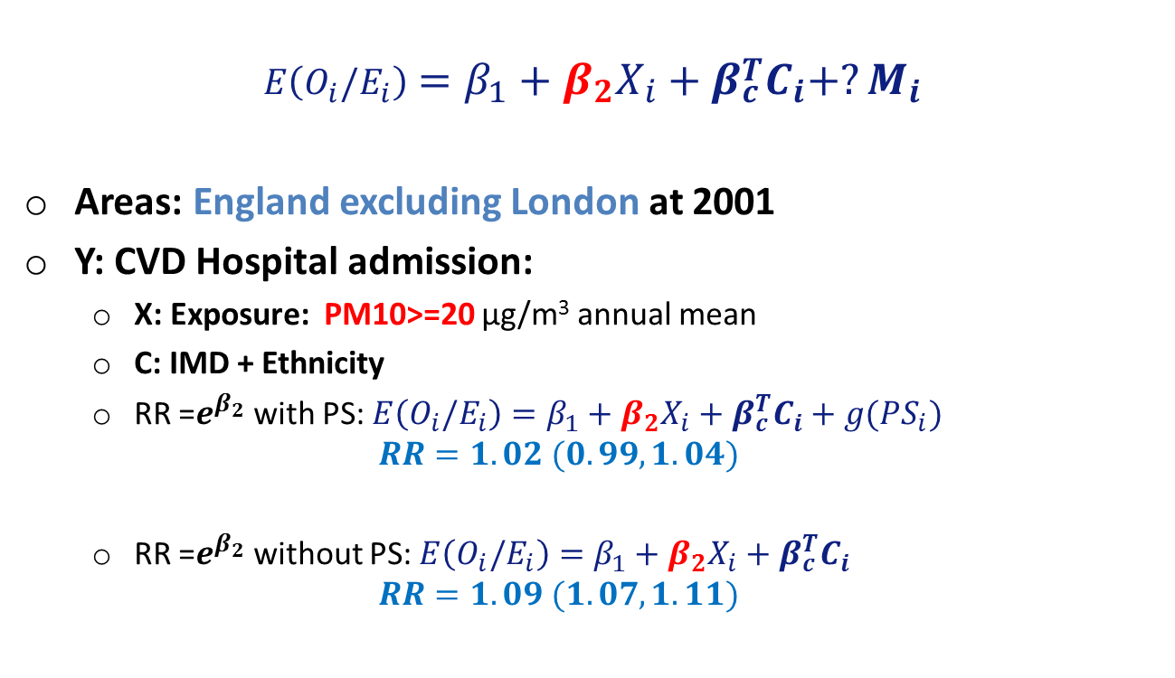
The RR for PM10
England excluding London
$$E\left(O_{i}/E_{i}\right)=β_{1}+β_{2}X_{i}+β_{c}^{T}C_{i}+?M_{i}$$
Areas: England excluding London at 2001
Y: CVD Hospital admission:
  X: Exposure: PM10>=20 μg/m³ annual mean
  C: IMD + Ethnicity
  RR =$e^{β_{2}}$ with PS: $E\left(O_{i}/E_{i}\right)=β_{1}+β_{2}X_{i}+β_{c}^{T}C_{i}+g(PS_{i})$
  $$RR=1.02 (0.99,1.04)$$
  RR =$e^{β_{2}}$ without PS: $E\left(O_{i}/E_{i}\right)=β_{1}+β_{2}X_{i}+β_{c}^{T}C_{i}$
  $$RR=1.09 (1.07,1.11)$$

Slide 16
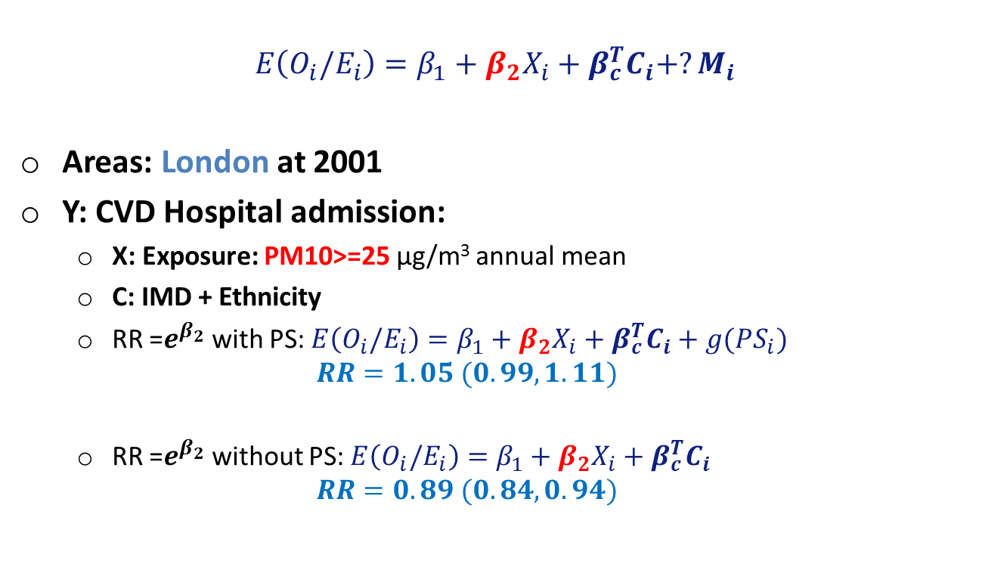
The RR for PM10
London
$$E\left({O_{i}/E}_{i}\right)=β_{1}+β_{2}X_{i}+β_{c}^{T}C_{i}+?M_{i}$$
Areas: London at 2001
Y: CVD Hospital admission:
  X: Exposure: PM10>=25 μg/m³ annual mean
  C: IMD + Ethnicity
  RR =$e^{β_{2}}$ with PS: $E\left(O_{i}/E_{i}\right)=β_{1}+β_{2}X_{i}+β_{c}^{T}C_{i}+g(PS_{i})$
  $$RR=1.05 (0.99,1.11)$$
  RR =$e^{β_{2}}$ without PS: $E\left(O_{i}/E_{i}\right)=β_{1}+β_{2}X_{i}+β_{c}^{T}C_{i}$
  $$RR=0.89 (0.84,0.94)$$

Slide 17
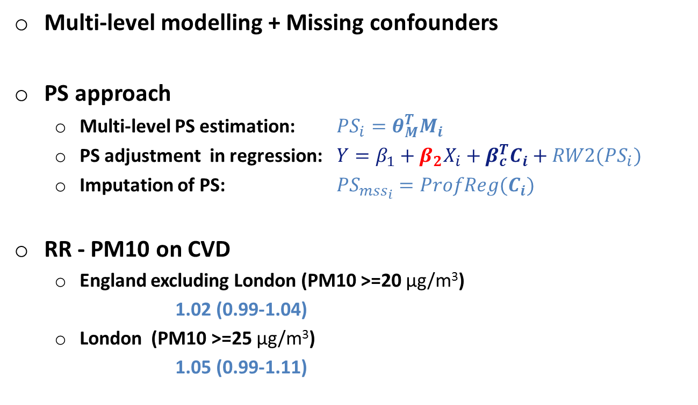
Summary
Multi-level modelling + Missing confounders
PS approach
  Multi-level PS estimation: $PS_{i}=θ_{M}^{T}M_{i}$
  PS adjustment in regression: ${Y=β}_{1}+β_{2}X_{i}+β_{c}^{T}C_{i}+RW2(PS_{i})$
  Imputation of PS: $PS_{mss_{i}}=ProfReg(C_{i})$
RR - PM10 on CVD
  England excluding London (PM10 >=20 μg/m³)
  1.02 (0.99-1.04)
  London (PM10 >=25 μg/m³)
  1.05 (0.99-1.11)

Slide 18
Acknowledgement
Supervisors:
Marta Blangiardo,
Nicky Best,
Sylvia Richardson
Statistical discussions:
Juan Gonzalez
Geography and pollution data assistance
Daniela Fecht
Kees De Hoogh
Database manager and IT support
Peter Hambly
Eric Johnson

Slide 19
References
McCandless, L. C., Richardson, S., and Best, N. (2012). Adjustment for missing confounders using external validation data and propensity scores. Journal of the American Statistical Association, 107(497):40–51.
Molitor, J., Papathomas, M., Jerrett, M., and Richardson, S. (2010). Bayesian profile regression with an application to the national survey of children’s health. Biostatistics, 11(3):484–498.
Muller, P., Quintana, F., and Rosner, G. L. (2011). A product partition model with regression on covariates.
Journal of computational and graphical statistics : a joint publication of American Statistical Association, Institute of Mathematical Statistics, Interface Foundation of North America, 20(1):260–278. PMID: 21566678 PMCID:PMC3090756.
Ohlssen, D. I., Sharples, L. D., and Spiegelhalter, D. J. (2007). Flexible random-effects models using bayesian
semi-parametric models: applications to institutional comparisons. Statistics in Medicine, 26(9):2088–2112.
Mason, A., Richardson, S., Plewis, I., and Best, N. (2011). Strategy for modelling non-random missing data
mechanisms in observational studies using bayesian methods. www.bias-project.org.uk.
Besag, J., York, J. and Mollie, A. (1991). Bayesian image restoration, with two applications in spatial statistics, Ann. Inst. Statist. Math., 43, 1-59.
Zigler, C. M., Watts, K., Yeh, R. W., Wang, Y., Coull, B. A., & Dominici, F. (2013). Model Feedback in Bayesian Propensity Score Estimation. Biometrics. doi:10.1111/j.1541-0420.2012.01830.x
    McCandless, L. C., Douglas, I. J., Evans, S. J., & Smeeth, L. (2010). Cutting feedback in Bayesian regression adjustment for the propensity score. The International Journal of Biostatistics, 6(2), Article 16

