Slide 1
Sample size optimization in BA and BE trials using a Bayesian decision theoretic framework
Paul Meyvisch – An Vandebosch
BAYES 2014 - London

Slide 2
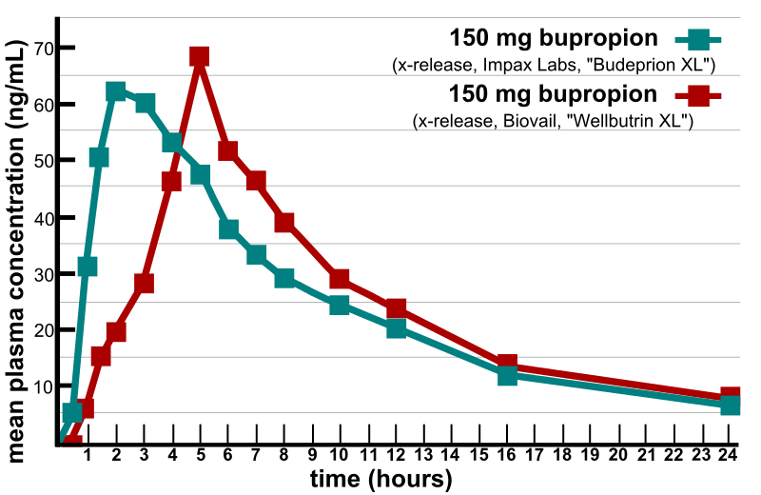
Background
PK : Pharmacokinetics
Bioavailability (BA) expressed as
AUC : area under the concentration curve
C_{max} : maximal concentration
Typically lognormally distributed
Bioequivalence (BE)
Relative BA (ratio) between 2 formulations is similar; contained within clinically relevant limits
Statistical evalution
Two formulations are bioequivalent when the 90% confidence interval of the geometric mean ratio (test/reference) of AUC and C_{max} is contained within [80%,125%]

Slide 3
Assumptions
We assume
A single test formulation is compared with a reference
Intra-subject SD of AUC and Cmax is known
Typically, variability is larger on Cmax – hence focus on a single parameter
BA and BE trials are designed using 2-way crossover designs
Same design
Same population
Same statistical model/analysis
...
Different in objective : learning versus confirmatory

Slide 4
Taking one step back
Drug development is much about learning and proceeding to a next stage.
We investigate the idea that sample size of next stage can not be disconnected from the results of the learning phase
A “No Go” means :
-“it is likely that the drug does not work”
-”the next stage requires a too high sample size to differentiate from the control arm”

Slide 5
Taking one step back
BA to BE serves as a laboratory experiment.
Early phase trials typically differ from late phase trials in population, duration of treatment, endpoint (biomarker vs clinical)....not so with BA-BE
Return on investment does not depend on competitive landscape

Slide 6
BA-BE sequence of trials
BA trial for learning
Conduct BA trial
Decision rule
No
Yes
Discard Formulation
Conduct BE Trial
Success?
No
Yes
Failure
Declare BE

Slide 7
Motivating Example (2010) Bioavailability trial Darunavir (DRV)
Test product vs Commercial Formulation (Reference)
PK DRV (fasted) | Geometric Mean Ratio (GMR) % (N=16) | 90% CI (N=16)
C_{max} (ng/mL) | 106.20 | (95.20 – 118.48)
AUC_{last}(ng.h/mL) | 108.14 | (93.76 – 124.72)
PK DRV (fasted) | Geometric Mean Ratio (GMR) % (N=16) | 90% CI (N=16)
C_{max} (ng/mL) |  | (95.20 – 118.48)
AUC_{last}(ng.h/mL) |  | (93.76 – 124.72)

Slide 8
Motivating Example Bioavailability trial Darunavir (DRV)
Based on BA results, the team wanted to ‘shoot for success’
BE trial design:
90% power
assumed difference test/reference 10%
Sample size =80 (!)
....6 months later....
BE Results: Test and reference statistically met bioequivalence criteria; estimated GMR approximately 100%
However, 96 subjects were ‘spent’ to prove the obvious

Slide 9
BA/BE: Decision rule at BA stage
How can we define “success” in a BA trial?
Goal: select promising formulations for formal BE testing
Define an acceptance range for GMR to identify promising formulations ⁽¹⁾
Quantify expected gain/loss associated with each decision (Bayesian decision theory)⁽²⁾
Is performing a BA trial helpful at all (cost-effectiveness versus learning)?
(1) Wang and Zhou, “Pilot trial for the assessment of relative bioavailability in generic drug
product development: statistical power.” Journal of Biopharmaceutical Statistics, 9(1),
179-187 (1999)
N. Stallard, “Sample size determination for phase 2 clinical trials based on Bayesian decision
theory.” Biometrics 54 279-294 (1998)

Slide 10
Acceptance Range approach (Frequentist)
Promising formulation: a formulation that has the potential to establish BE with sufficient power and a reasonable sample size
Evaluated on BA results
Define an acceptance range for the GMR to identify promising formulations
The approximate sample size formula for BE trials is of the following form:
$$n≥2{(\frac{σ_{w}}{\log\left(1.25\right)−Δ_{BA}})}^{2}{\left(t\left(1−α,n−2\right)+t\left(1−β,n −2\right)\right)}^{2}$$

Slide 11
Acceptance Range approach
Substituting n for N_{max} we can easily solve for Δ_{BA,} which should now be interpreted as the upper end of the acceptance range (on log scale):
$Δ_{BA}=log⁡(1.25$)$−\sqrt{\frac{2}{N_{max}}}σ_{w}\left(t\left(1−α,N_{max}−2\right)+t\left(1−β,N_{max}−2\right)\right)$
Do note that Δ_{BA} only depends on $σ_{w}$ for given N_{max} and $β$.

Slide 12
Acceptance Range approach
Decision rule : log(${\hat{μ}}_{BA})$ $∈[−$ Δ_{BA ,} Δ_{BA} ]
By construction it follows that :
n_{BE} = n_{BE} (σ_{w}, ${\hat{μ}}_{BA}$, α, 1−β) $≤ N_{max}$
This can be reformulated in a Bayesian manner with noninformative prior (next slide)
n_{BE} depends on the BA results

Slide 13
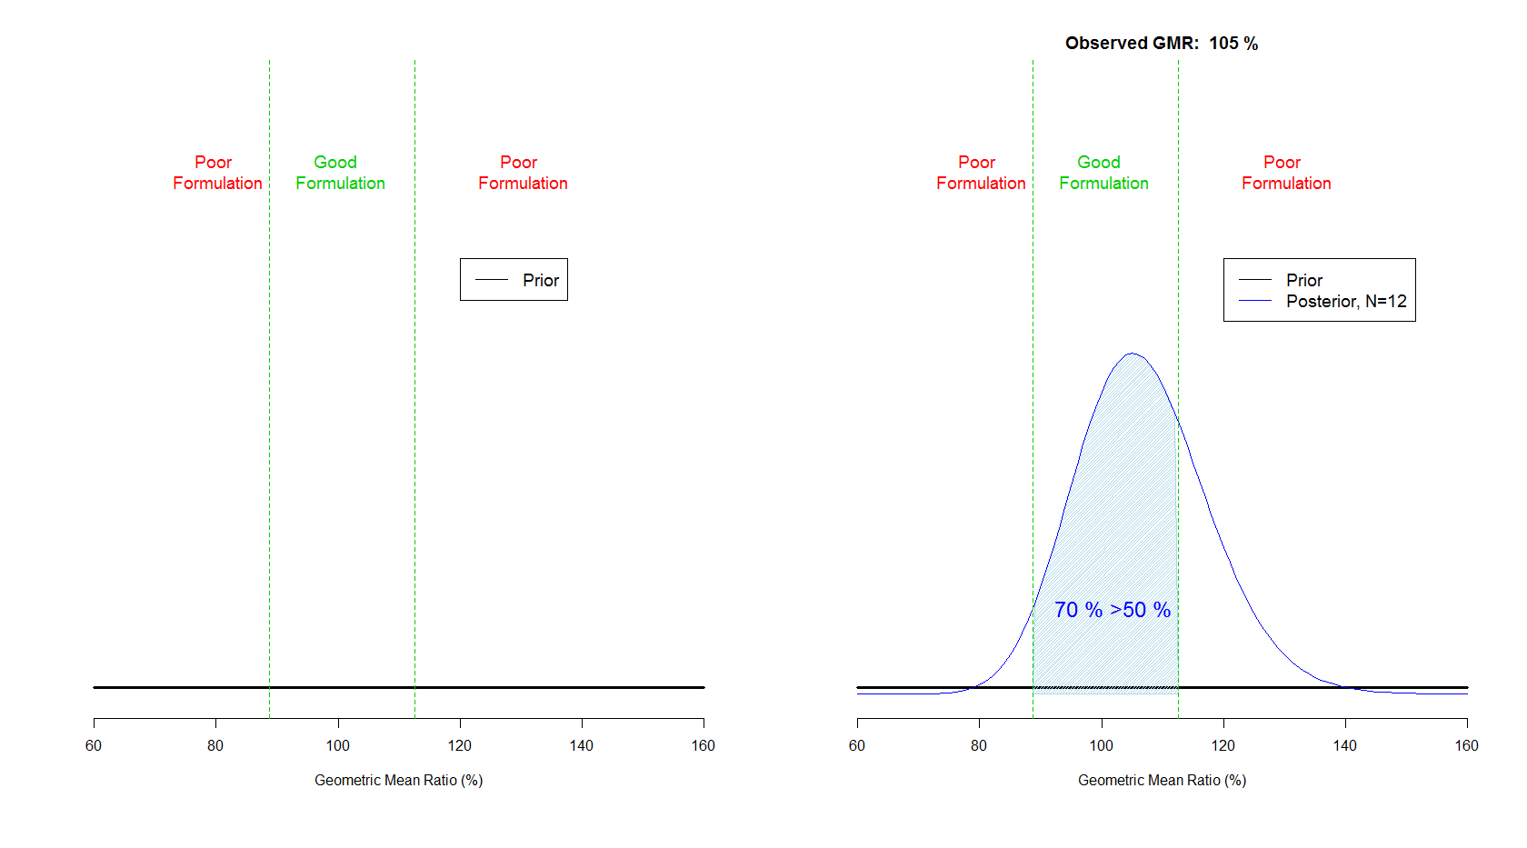
Acceptance Range Approach (Bayesian formulation)
Posterior probability that GMR is contained within acceptance range is ≥ 50%
P(-log(Δ_{BA} )<μ<(log(Δ_{BA} ))≥50%

Slide 14
Bayesian decision theoretic framework
Optimize sample size for BA and BE trials for a range of scenarios using a bayesian decision theoretic framework
This requires definition of gain functions associated with either of two possible actions:
Action A : Abandon development of test formulation
Action P : Proceed to a BE trial

Slide 15
Definition of gain (utility) function
Gain functions in clinical trials must be expressed on a common scale
Financial (investment costs and potential financial rewards)
We consider sample size as a surrogate for the cost
Financial reward is substituted by the maximum number of subjects the company is willing/able to spend on a bioequivalence trial

Slide 16
Definition gain function
Suppose decision is to stop after BA:
further development abandoned
cost spent is sample size BA trial
No financial reward
Hence, associated gain function:
G_{abandon}= −n_{BA}

Slide 17
Notation (2)
Gaussian conjugate prior for $μ$, variance fixed
Denote $μ_{BA}$ the mean of the posterior distribution of the geometric mean ratio $$
n_{BE} = n_{BE} (σ_{w},${ μ}_{BA}$, α=5%, 1−β=90%)
n_{BE} depends on the BA results

Slide 18
Definition gain function
Decision is to proceed to BE:
cost spent is sample size BA trial and BE trial
N_{max} is the surrogate for the financial reward; the reward is obtained when BE trial is successful
Hence, associated gain function:
G_{proceed}= −n_{BA} − n_{BE} + N_{max}×E(κ⏐μ)
Expected power of BE
given updated knowledge
on μ (posterior)
“Financial reward”

Slide 19
Bayesian Decision versus Acceptance range approach
Bayesian Decision theory gain functions
n_{BE} < N_{max}×E(κ⏐μ)
(frequentist) Acceptance Range approach
n_{BE} < N_{max}

Slide 20
Bayesian Decision Approach
Decision Rule at trial (BA) level:
Proceed further development when G_{proceed} > G_{abandon}
Condition met when n_{BE} < N_{max}×E(κ⏐μ)
Intuitively, sample size BE trial (derived from BA results) is smaller than expected financial reward

Slide 21
Evaluating operational characteristics
Simulation study to evaluate
typical BA sample size
Probability of success of decision rule as a function of the BA sample size
For highly variable (intra-subject SD>0.3), low variable (intra-subject SD<0.15) and moderately variable compounds

Slide 22
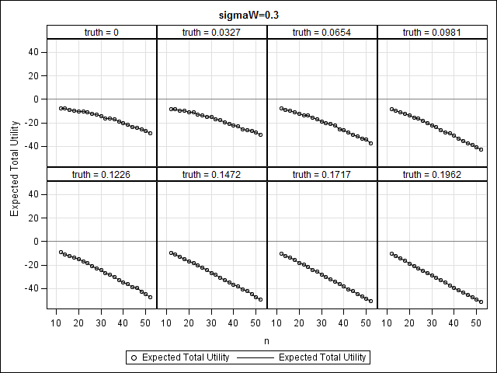
(Highly) variable drugs : σ_{w}≥0.3 noninformative prior
G_{abandon}≈ −n_{BA}

Slide 23
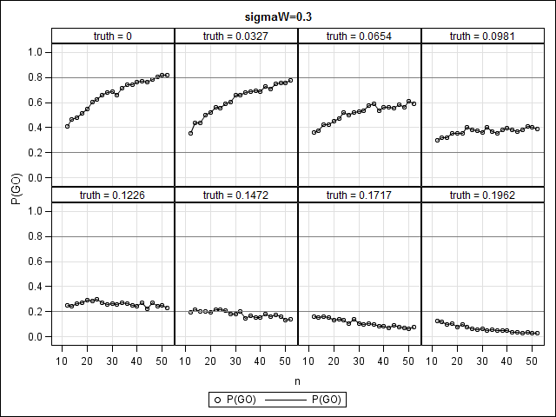
(Highly) variable drugs : σ_{w}≥0.3 noninformative prior
N_{BA}=50

Slide 24
Conclusions (Highly) variable drugs : σ_{w}≥0.3
Gain functions similar across range of true values of μ
Little benefit in doing a BA trial at all?
High sample size is required (n_{BA}>48) to advance a good formulation to the pivotal stage
No “return on BA investment” at the BE level
Requirement of 90% power and N_{max}=100 too stringent

Slide 25
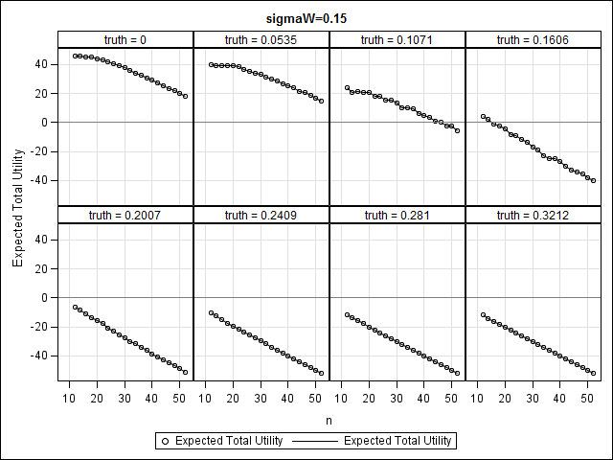
Drugs with low variability: σ_{w} $≤0.15$ noninformative prior
G_{abandon}≈ −n_{BA}

Slide 26
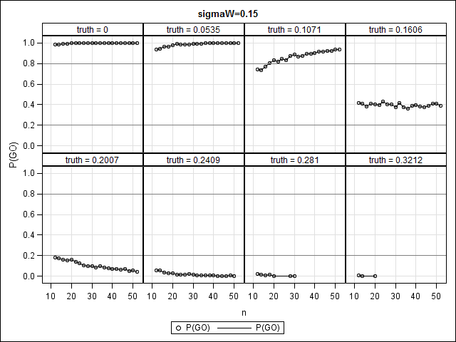
Drugs with low variability: σ_{w} $≤0.15$ noninformative prior
N_{BA}=12

Slide 27
Drugs with low variability: σ_{w} $≤0.15$ non-informative prior - conclusions
Utility strongly dependent on the ‘true value’ of μ.
No maximum observed in utility functions, suggesting no need for a BA trial – or conduct a BA trial with n_{BA} =12
Favorable operational characteristics for n_{BA} =12

Slide 28
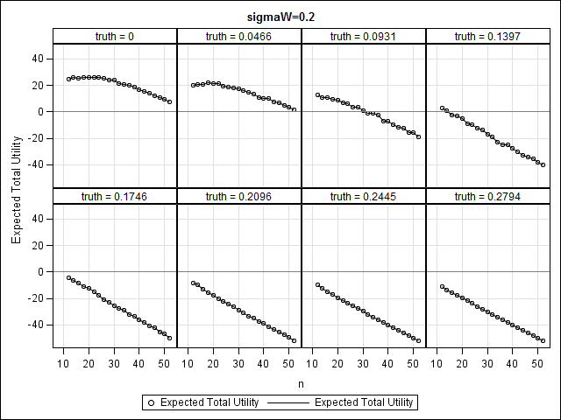
σ_{w} $=0.2$ noninformative prior
Optimum at
N_{BA}=18

Slide 29
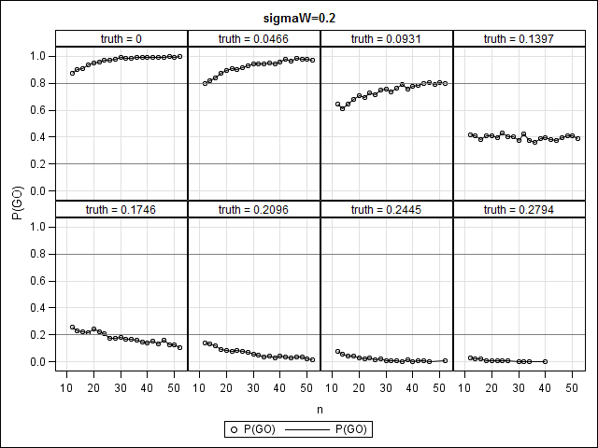
σ_{w} $=0.2$ noninformative prior

Slide 30
A note on the use of informative priors
Prior knowledge from in-vitro tests can be incorporated, if possible. A plausible choice would be a Gaussian conjugate prior with $μ$=0 and variance fixed
Use of informative priors defeats the purpose of a ‘learning’ BA trial.
Even less interest in a learning trial
In case of poor formulation, higher sample size is needed for favorable operational characteristics (=inefficient).

Slide 31
Conclusions
There are situations in which it may not be cost-effective to do a BA trial.
Highly variable drugs in combination with too low N_{max}
Drugs with very low variability
For drugs with moderate variability, a BA trial with n_{BA}=18 can be considered.
Use of strong priors ($μ$=0) is inefficient : rather use the prior information as the rationale to skip the BA trial.

Slide 32
Thank You!
pmeyvisc@its.jnj.com

