Slide 1
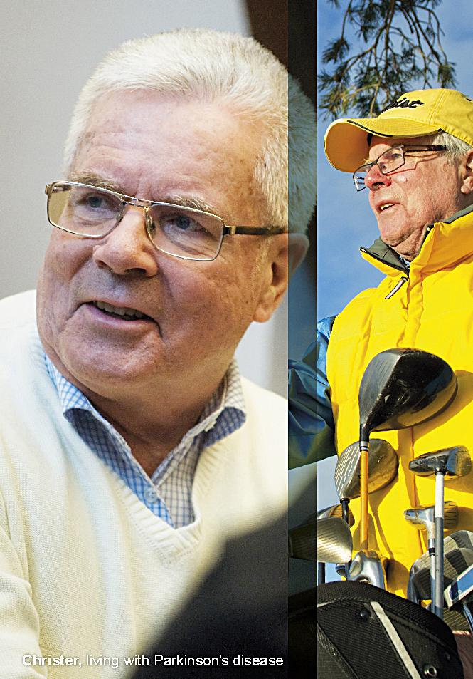
Clinical and pre-clinical applications of Bayesian methods at UCB
Foteini Strimenopoulou and Ros Walley
Bayes Conference
13.06.2014

Slide 2
Agenda
Clinical
  Building priors
  Bayesian design
  Bayesian decision making
Pre-clinical
  Strategy
  First steps: QC charts
  Types of control groups
  Bayesian methodology
  Results of Bayesian pilot
Conclusions
Acknowledgements/References

Slide 3
Building a prior
General remarks on the UCB practice
For PK studies
    Informative priors on PK model parameters for new compound based on
        in-house data (i.e. primate PK parameters allometrically scaled, other mAb parameter values from clinical data)
        literature data
For POC studies
    Informative priors only on the placebo response or the active comparator
        Not on treatment difference, nor the experimental drug arm
    Internal decision making

Slide 4
Building a prior
Categories of priors used for assessing efficacy for early decision making studies
Meta-analytic-predictive approach (Neuenschwander et al., 2010)
    available info from many heterogeneous studies
‘Discounted’ prior
    When only one historical study available
    Arbitrary discounting to account for study to study variability
        Normal case: inflate variability by 2*SEM ➔ discounted prior reduces the effective sample size by 75%
        Binary case: Beta(a/4,b/4) ➔ discounted prior reduces the effective sample size by 75%
Uninformative/vague prior
    Unreliable papers
    New endpoint/biomarker
    Early stage of design
    No expertise available at the analysis stage

Slide 5
Building a prior
Case study: Meta-analytic-predictive approach
Type of study: Phase I, allergen challenge study, parallel group design
Endpoint: % Max fall in FEV1 in late phase
Aim of the meta-analysis: Build a prior for the placebo response
Studies | N | Mean | SD
Study 1 | 13 | -19.30 | 9.6
Study 2 | 13 | -20.90 | 11.3
Study 3 | 12 | -23.10 | 12.2
Study 4 | 15 | -27.60 | 8.3
Study 5 | 9 | -17.80 | 13.9
Table 1. Information on the placebo % Max fall in FEV1 from relevant studies in the literature
Prior effective sample size:
11 placebo patients

Slide 6
Building a prior
Case study: Comparison of approaches
Case: Many studies available → Meta-analytic-predictive prior
Case: Only one study available → ‘discounted’ prior
Case: No study available → Uninformative prior
Studies | N | Mean | SD
Study 1 | 13 | -19.30 | 9.6
Study 2 | 13 | -20.90 | 11.3
Study 3 | 12 | -23.10 | 12.2
Study 4 | 15 | -27.60 | 8.3
Study 5 | 9 | -17.80 | 13.9
Studies | N | Mean | SD
Study 1 | 13 | -19.30 | 9.6
Study 2 | 13 | -20.90 | 11.3
Study 3 | 12 | -23.10 | 12.2
Study 4 | 15 | -27.60 | 8.3
Study 5 | 9 | -17.80 | 13.9
Studies | N | Mean | SD
Study 1 | 13 | -19.30 | 9.6
Study 2 | 13 | -20.90 | 11.3
Study 3 | 12 | -23.10 | 12.2
Study 4 | 15 | -27.60 | 8.3
Study 5 | 9 | -17.80 | 13.9
ESS = 11
ESS = 13
ESS = 3
ESS = 0

Slide 7
Agenda
Clinical
  Building priors
  Bayesian design
  Bayesian decision making
Pre-clinical
  Strategy
  First steps: QC charts
  Types of control groups
  Bayesian methodology
  Results of Bayesian pilot
Conclusions
Acknowledgements/References

Slide 8
Bayesian Design
Sample size determination
Classical approach
  Choose N such that a treatment effect significant at level α will be found with probability 1-β, if the magnitude of treatment effect is δ.
Bayesian approaches (considered at UCB)
  Choose N large enough to ensure that the trial will provide convincing evidence that treatment is better than control based on a chosen success criterion (see for implementation on normal case Walley et al. submitted)
  Choose N large enough to ensure that the trial will either provide convincing evidence that treatment is better than control or convincing evidence that treatment is not better than control by some magnitude δ (see for implementation Whitehead et al. 2008)
Ultimate aim:
Determine the sample size such that at the end of the study we will be able to make robust decisions while we keep the cost of the study to a minimum.

Slide 9
Bayesian Design
Decision rules for each approach (1-sided tests)
Classical approach
Pr(X>x|H₀) < α
For determining the sample size, we require Pr(X>x|H₁) >1-β is satisfied
Bayesian approaches
Walley et al.
    Success criterion S: Pr(δ > 0|data) > 1-α
    Sample size such that Pr(S| δ = δ*) > 1-β
Whitehead et al.
    Success criterion: Pr(δ >0|data) > η
    Sample size based on 2 criteria: ensure the above, if experimental treatment better than control, or if not, ensure that P(δ < δ*|data) > ζ
    For what follows we choose η=1- α and ζ=1-β

Slide 10
Bayesian Design
UCB general practice
Use Bayesian design (for POC studies) to:
    ‘Improve’ operating characteristics given a ‘fixed/classical’ sample size
    Reduce sample size for given ‘classical’ operating characteristics
        Usually when very restricted budget
Assumptions regarding the data variability when designing a study
    Fixed/known data variability
    Unknown data variability
        A uniform distribution (on plausible values) for the standard deviation (as in Walley et al. submitted)
        An inverse gamma distribution on variance (as in Whitehead et al. 2008)

Slide 11
Bayesian Design
Case study… continued…
Prior for the treatment effect – as seen previously (predictive-meta-analytic approach)
Prior for data variance
    After fitting the hierarchical model for the meta-analysis, we have the following posterior for the standard deviation
    From the above posterior distribution we choose the range of ‘plausible’ values and assume a uniform distribution (as in Walley et al. submitted) for it, i.e.
      s~Unif(9.3, 13.4) → 5th and 95th percentile of the posterior
      Good enough fit?
    Using the Whitehead et al. approach, then the variance prior used would be approximately
      s²~InvGamma(shape=29, scale=3540)
      Use this to address sensitivity on the choice of the prior
Figure 1. Posterior distribution of the standard deviation

Slide 12
Bayesian vs. Classical design
Fixed: N active =20, N placebo = 10, 1-sided α=2.5%
Clinically relevant effect:
30% inhibition, i.e. δ*=-7
Recommendation: Too small sample size for a robust decision at the end of the study – change the design
Classical Power/
Conditional probability of a Go decision
20% increase
δ*

Slide 13
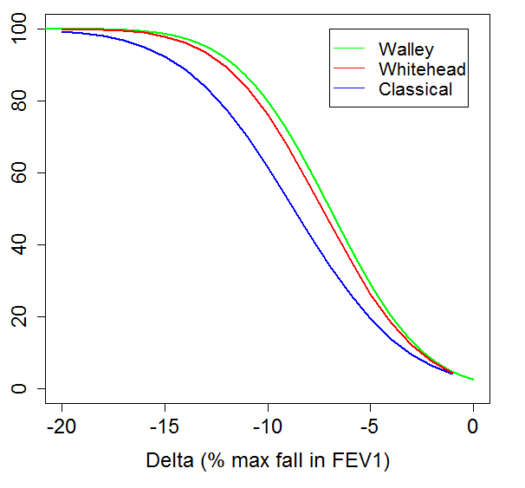
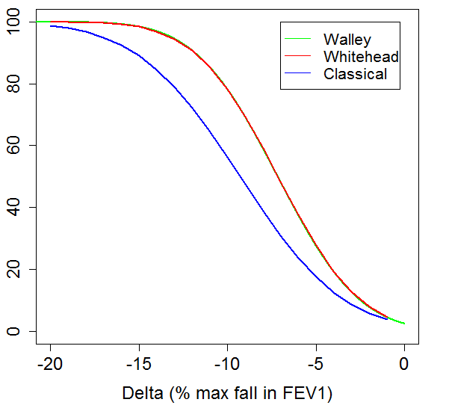
Bayesian (known/unknown variability) vs. Classical design
Fixed: N active =20, N placebo = 10, 1-sided α=2.5%
Unknown variability
Walley et al: Uniform on s
Whitehead et al: Inverse Gamma on s²
Known variability
Classical Power/
Conditional probability of ‘Success’
Classical Power/
Conditional probability of a ‘Success’

Slide 14
Agenda
Clinical
  Building priors
  Bayesian design
  Bayesian decision making
Pre-clinical
  Strategy
  First steps: QC charts
  Types of control groups
  Bayesian methodology
  Results of Bayesian pilot
Conclusions
Acknowledgements/References

Slide 15
Bayesian analysis/decision making
General remarks
Clearly defined study success criteria at the design state that remain the same at the decision making stage
Same priors as in design stage or updated prior to include new info
Same model or more complex model than the study design stage
    E.g. including covariates

Slide 16
Bayesian analysis/decision making
Case study Intro
Type of study: FIM on patients, placebo controlled, single dose escalating study
Study objectives: Safety, tolerability, PK and PD (decision making at top cohort)
Design considerations (for PD part):
    Clinically relevant effect : at least 60% improvement over placebo on endpoint X at week 2
    Uninformative priors (endpoint defined slightly different between papers)
    N=6 top cohort , N=12 placebos (pooled)
Model assumed
    Y_{ij}~ N(α_{j} + β*baseline_{ij}, σ²)
        Y_{ij} : the PD variable at Week 2 for subject i in treatment group j
        α_{j} : the mean (corrected for baseline) of the PD variable under treatment group j
        baseline_{ij}: value for baseline (predose) for subject i in treatment group j.
Decision rules (Go)
    Pr(% improvement over placebo > 0%) > 97.5%
    Pr(% improvement over placebo > 60%) > 50%

Slide 17
Case study (dummy) results – Bayesian analysis
Figure 2: Posterior distribution of % improvement over placebo in the clinical marker of interest
Primary endpoint analysis at week 2
 | No of subjects | Posterior median of the endpoint at Week 2 | Posterior median % improvement (Compound vs. Placebo) | 95% credible interval | Probability the % improvement is greater than
 |  |  |  |  | 0% | 60%
Compound | 6 | 0.5 | 78% | 65%, 85% | >99% | >95%
Placebo | 12 | 3.5
Study Go criteria on efficacy would be met

Slide 18
Experience with Bayesian Methods
Clinical perspective
Technical issues:
  In constructing priors
        How much to discount literature data?
        Need to allow for study-to-study variation
        Eliciting information from experts
        Translation of animal data
  Check for prior-data conflict
  Need to assess convergence of model
Our stakeholders:
  More flexibility -> more discussion at start
  Confusion between
        Traditional 80% power for a 50% increase
        Being 80% sure the drug has a effect of at least 50%
  Informative priors can reduce/increase size of estimated treatment effect
  Comfort with posterior probabilities?

Slide 19
Agenda
Clinical
  Building priors
  Bayesian design
  Bayesian decision making
Pre-clinical
  Strategy
  First steps: QC charts
  Types of control groups
  Bayesian methodology
  Results of Bayesian pilot
Conclusions
Acknowledgements/References

Slide 20
Strategy to demonstrate impact pre-clinically
Features of Bayesian designs
  Explicit way of combining information sources
  Forces early agreement as to relevance of all information sources
  Reduce costs and resources (animal numbers) through informative priors/predictive distributions
  Reduce costs and resources through interim analysis
  Allows more relevant statements to be made at the end of the study e.g. the probability the response rate for drug A is more than 10% better than drug B
    Ranking compounds
    Comparing a combination with its components
  Flexibility in estimation. E.g. one can analyse on the log scale and estimate differences on the linear scale
  Allows for a wide variety of models to be fitted and can address issues such as lack of convergence or outlier-prone data
  Model averaging, model selection

Slide 21
Strategy to demonstrate impact pre-clinically
“Selling points of Bayesian methods”
High impact
  Focus on in vivo studies that are run again and again
  Saving even a few animals per study results in large savings, easily demonstrated
Ground-breaking
  Quick search in the literature suggests little use in vivo except some focused applications:
    PK & PK/PD models
    SNPS/genes – pathway analysis. Including a Nature reviews article called “The Bayesian revolution in genetics”
    Lookup proteins
Complements clinical strategy
*

Slide 22
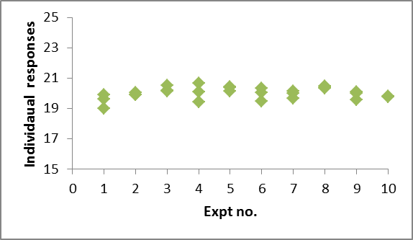
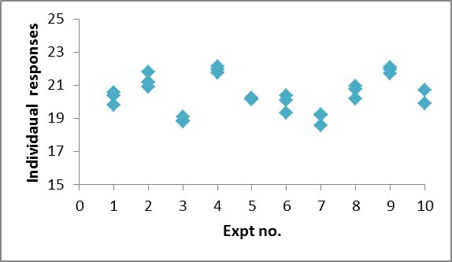
First steps: QC charts
Well received.
Introduces the idea of expt-to-expt variation:
  Intuitively, the relevance of the historic controls depends on the size of the study to study variation.
Low expt-to-expt variation
High expt-to-expt variation
Bayesian analysis can use the historic control information, down-weighting it according to the amount of experiment-to-experiment variation

Slide 23
Types of control groups
    Not used for formal statistical comparisons. Example uses:
      To ensure challenge is working; to establish a “window”; to check consistency with previous studies; to convert values to %.
      Replace group with a range from a predictive distribution
    Used for formal comparison vs. test compounds/doses
      Used as the comparison in t-tests ..etc
      Combine down-weighted historic data with the current experiment

Slide 24
Bayesian methodology
Outline
    Analyse historic control treatment group data, excluding the last study.
      Bayesian meta-analysis
    Analyse the last study
      Show what would have happened if we had “bought into” the Bayesian approach; omit animals if necessary
    Possible options for future studies:
      Omit all/some animals from all/some control groups.
      Use historic data as prior information combined with observed data in a Bayesian analysis.
      Use historic data to give a predictive distribution for control group. i.e. don’t include that treatment group in current study.
    Statistical model based on methodology in Neuenschwander et al

Slide 25
Bayesian methodology (2)
“Replacing” control groups with predictive distributions
Bayesian analysis of historic control data
New study data:
8 per group (for the other groups)
QC-chart like limits for control group
Traditional analysis of current study
Overlay Bayesian analysis in data presentations
Suitable for control groups not used in statistical comparisons

Slide 26

Bayesian methodology (3)
“Replacing” control groups with predictive distributions

Slide 27
Bayesian methodology (4)
Full Bayesian analysis
Bayesian analysis of historic control data
Effectively N control animals with mean, m
New study data:
8 per group
Bayesian analysis of current study
Suitable for any control groups but requires a Bayesian analysis for each data set.
Results and
conclusions
This is a simplification of the exact analysis

Slide 28
Results of Bayesian pilot (so far)
Assess impact of Bayesian analysis of last study terms of
    Approx. effective sample size of prior
    Impact on 95% CIs of means and treatment differences
Full Bayesian analysis for each study
    Software issues & turnaround times
    Approximate with normal prior, normal data, known variance?
One assay considered so far:
    High throughput; high profile
    Modest savings in numbers of animals for full Bayesian approach
    Biologists positive about adopting predictive approach
    For full Bayesian analysis, biologists suggested starting with something slightly more low-key

Slide 29
Conclusions
Bayesian methods with informative priors can reduce required resource
Internally we can easily implement these methods
Need to allow extra time for design work
Care is required for communication with project teams
To show impact of Bayesian stats pre-clinically, we need to focus on the right studies.
      If studies are repeated several times a month, then even small savings in the numbers of animals per study will have a big impact.
QC charts provided an excellent introduction to between and within study variation
Even for well controlled in vivo experiments study-to-study variation is not negligible

Slide 30
References
Neuenschwander, B., Capkun-Niggli, G., Branson, M. and Spiegelhalter, DJ. Summarizing historical information on controls in clinical trials., Clin Trials 2010 7: 5
Walley, RJ., Birch, CL., Gale, JD., and Woodward, PW. Advantages of a wholly Bayesian approach to assessing efficacy in early drug development: a case study. Submitted
Whitehead, J., Valdés-Márquez, E., Johnson, P. and Graham, G. (2008), Bayesian sample size for exploratory clinical trials incorporating historical data. Statist. Med., 27: 2307–2327. doi: 10.1002/sim.3140
Beaumont and Rannala, The Bayesian revolution in genetics. Nature Reviews Genetics 5, 251-261 (April 2004)

Slide 31
Acknowledgements
Joe Rastrick
John Sherington
Alex Vugler
Gillian Watt

Slide 33
Thanks!

