Slide 1
Chinese Whispers
Tony O’Hagan

Slide 2
Outline
Language
Chinese whispers
The language of statistics
Probability
‘The’ or ‘Your’
Randomness and uncertainty
The message
Assurance
The rational, impartial observer
The other side
Communication is 2-way
Training

Slide 3
Language

Slide 4
Chinese whispers
Also known in America as the telephone game
In your country?
It’s too easy to think you understand

Slide 5
Voici la fenêtre
Here is the window
Here is the widow

Slide 6
Drop your pants
USA
UK

Slide 7
I’m getting the messages

Slide 8
Very likely
Terrorist attack at Sochi Olympics
> 90%
Very likely
Almost certain
IPCC 5th Assessment
The Independent
International Business Times

Slide 9
Two dialects
Statistics is a language for talking about uncertain things
But Bayesians and frequentists speak quite different dialects
Opportunities for Chinese whispers!
We use different words to describe the same things
And the same words to describe different things
I’m going to focus on the word ‘probability’
Perhaps because our dialects are designed to say different things
I’ll look at the way we express inferences

Slide 10
Probability

Slide 11
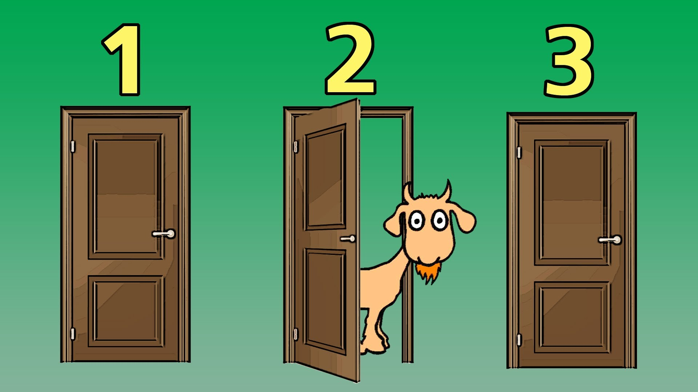
Paradox and confusion
People find probabilities confusing
And academics and teachers seem to love adding to the confusion

Slide 12
Probabilities are conditional
They change whenever the information changes
John and Mary have two children
One is a girl
The elder is a girl
One is a girl called Mary

Slide 13
Subjective probability
Probability depends on information
And no two people have the same information
Fundamental to the Bayesian dialect
Probability is a measure of personal degree of belief
There is no such thing as ‘the’ probability
There is only ‘your’ probability, ‘my’ probability, ‘her’ probability
What a frequentist calls a probability is not a probability
It’s a long-run limiting relative frequency
This is really important!

Slide 14
Frequency probability
Consider a new compound for rheumatoid arthritis
Patients respond/don’t respond on 20% ACR improvement criterion
Let p be the proportion p of responders in the population
In frequentist statistics, p is the probability of a patient responding
So p is an unknown probability
Can be estimated by proportion of responders in a sample
In subjective probability terms p is an unknown proportion
Conditional on p, patients respond with probability p
Your subjective probability of a patient responding is E(p)
With respect to your (subjective) distribution of p
There are no unknown probabilities

Slide 15
Getting the language right
There is no such thing as ‘the’ probability of an event
What frequentists call the probability is the population proportion
Your probability is your expectation of the proportion
If you train yourself to get the language right, consistently, you will communicate more clearly
In my training courses on eliciting expert knowledge, I emphasise this
Subjective probability judgements will be unfamiliar to the experts
They need careful training
During the elicitation, the facilitator must consistently use ‘your’

Slide 16
Uncertainty and variability
The distinction between probability and proportion is an example of a more general distinction
Consider a respiratory treatment where response is increase in FEV₁ from baseline
There is variability in patient responses
They form a distribution (not a probability distribution)
There is uncertainty about that distribution
For any parameter of which you have a probability distribution
For instance, mean response z is an uncertain parameter
You have a probability distribution for z
Your expected response for an individual patient is your E(z)

Slide 17
My favourite formula
Var(Y) = E{Var(Y | X)} + Var{E(Y | X)}
Y is individual patient response
X is population distribution

Slide 18
The message

Slide 19
Probability of success
What is the probability that your upcoming Phase 3 trial will deliver a significant treatment effect?
The trial was designed to give 90% power
So the probability of success is 0.9?
Wrong!
That’s just the proportion of trials that would give significant results if the true treatment effect equals the assumed design effect
Unless this is clearly explained, miscommunication is almost guaranteed
Assurance is your expectation of the power function
With respect to your (prior) distribution for the true treatment effect
This is where elicitation comes in
It’s your probability of success

Slide 20
Confidence interval (CI)
What is a confidence interval?
Suppose that [0.45, 0.57] is a 90% CI for a population proportion p
This will almost always be interpreted as saying that there is a 90% probability that 0.45 < p < 0.57
Which is wrong
Hardly any practicing statistician seems to understand this
And those that do never seem to explain the true meaning to their clients
Probably because the true interpretation is so convoluted!
Miscommunication is almost guaranteed

Slide 21
Credible interval (CrI)
The Bayesian analogue is the credible interval
Suppose that [0.45, 0.57] is your 90% CrI for a population proportion p
This is correctly interpreted as saying that you have a 90% probability that 0.45 < p < 0.57
This is easy to explain
So there is no excuse for failing to communicate
But you need to communicate ‘your’

Slide 22
Whose probabilities?
Who is ‘you’?
Literally!
Whoever is communicating the probabilities
The responsibility is yours
So you will want to be as well-informed and careful in your judgements as possible!
An excellent model for this is expert knowledge elicitation
It’s you!

Slide 23
Elicitation – whose probabilities?
When we elicit expert knowledge we elicit from experts
And invariably we use several experts
To gather a broad range of knowledge and opinion
My approach is to get experts together to discuss their judgements
In an elicitation workshop
We need to aggregate their judgements into a single probability distribution for the parameter of interest
But we can’t expect them all to have the same opinions
Even after sharing and discussing their knowledge and opinions
I ask them to judge what would be the beliefs of a rational, impartial observer
After seeing their individual judgements and hearing the discussion

Slide 24
The rational, impartial observer
I report the distribution of the rational, impartial observer
I have no knowledge of the subject myself
So I’m happy to accept that as my distribution
My client will also generally accept the experts’ distribution
But might modify it based on their own knowledge
So when you report your probabilities, you will wish them to be consistent with those of a rational, impartial person who has assimilated the evidence and knowledge of experts
You will seek the views of others if necessary
You will analyse data in a rational, impartial way
And the same goes for the company
When presenting to a regulator

Slide 25
The other side

Slide 26
Communication is a 2-way process
It’s no good speaking our Bayesian dialect clearly and consistently if the person you are communicating with doesn’t understand that dialect
No matter how clearly you explain, there is the danger of miscommunication
People need training
Management and decision makers within the company
Regulators
Even customers
But first they need persuading
People have to want the training

Slide 27
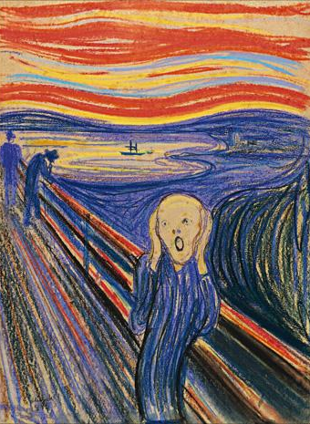
It won’t be easy
Resistance to subjective probability is a familiar hurdle
But we are also used to explaining why we can’t use the so-called objective frequency probabilities
Subjective!!

Slide 28
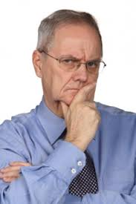
Subjective, but scientific (1)
You want to use subjective probability judgements? Isn’t that totally unscientific? Science is supposed to be objective.
Yes, objectivity is the goal of science, but scientists still have to make judgements. These judgements include theories, insights, interpretations of data. Science progresses by other scientists debating and testing those judgements. Making good judgements of this kind is what distinguishes a top scientist.

Slide 29
Subjective, but scientific (2)
But subjective judgements are open to bias, prejudice, sloppy thinking …
Subjective probabilities are judgements but they should be careful, honest, informed judgements. In science we must always be as objective as possible. Probability judgements are like all the other judgements that a scientist necessarily makes, and should be argued for in the same careful, honest, informed way.

Slide 30
Summary
This is my view
I’ve probably been wildly over-ambitious
But there are some key points here that I firmly believe
We need to present Bayesian findings honestly, clearly and consistently
Be open about the subjectivity – ‘your’, not ‘the’
Don’t slip into the wrong dialect
The people we present them to need to understand
Experience suggests they will misunderstand even if we explain well
Unless they are trained
And prepared to be trained
My experiences with teaching elicitation are my model

